Slide 1
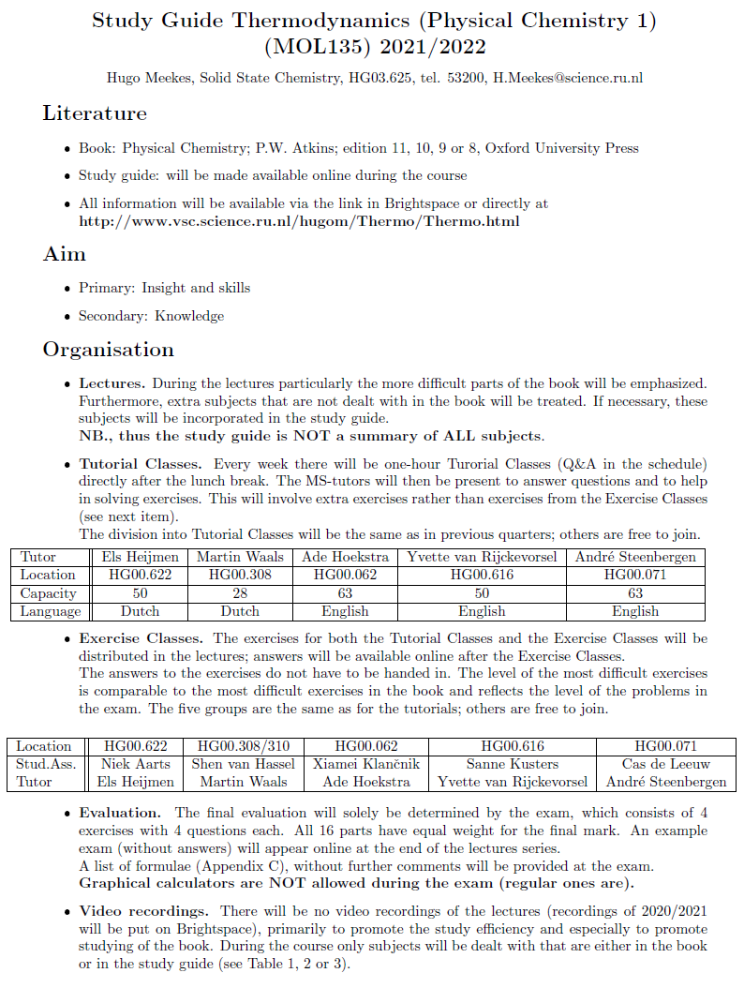

Slide 2
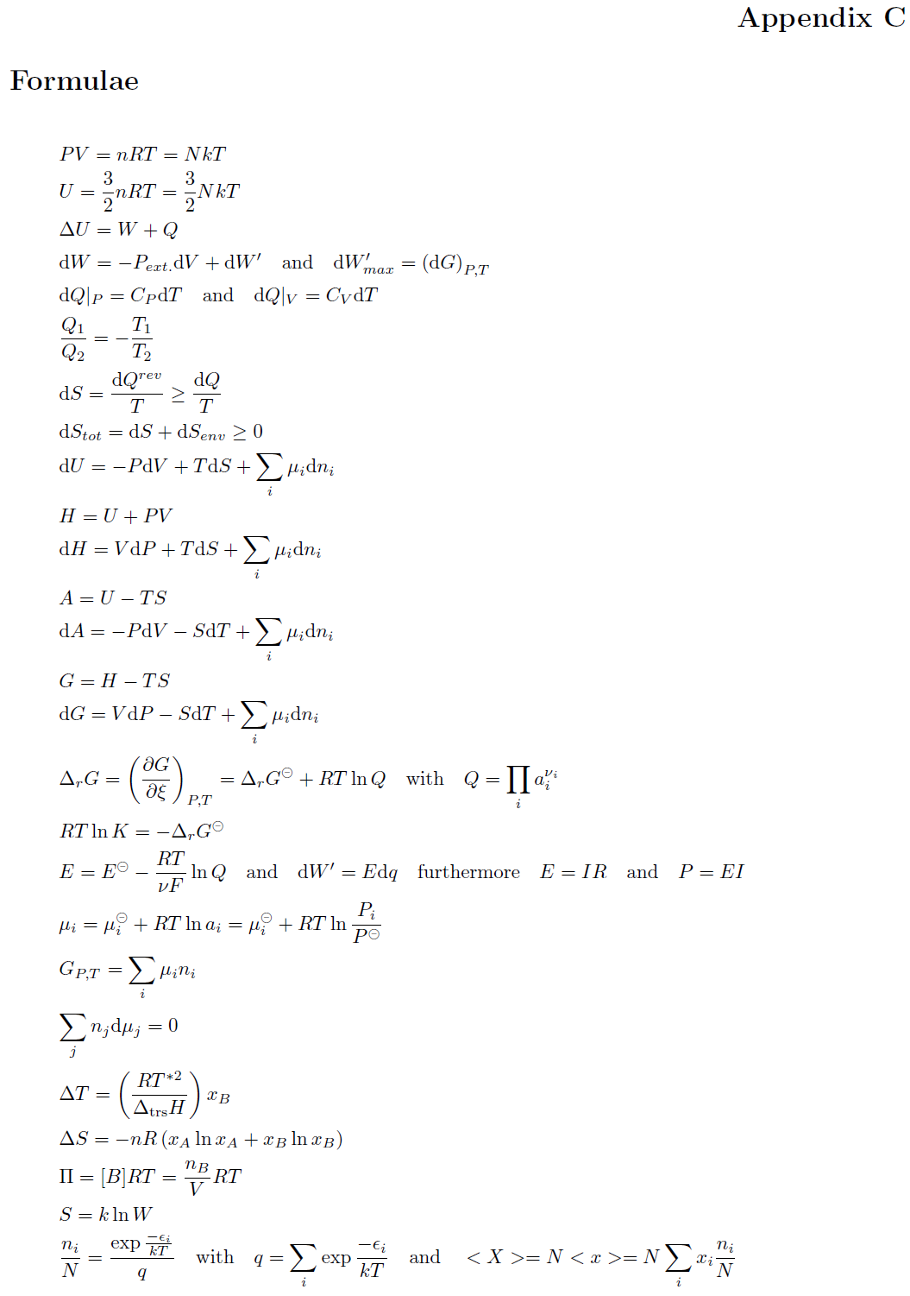

Slide 3
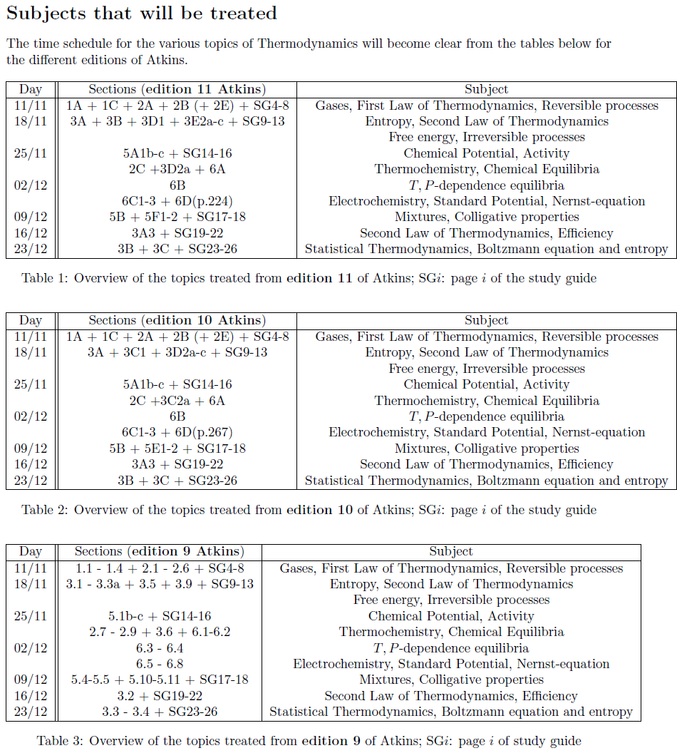

Slide 4
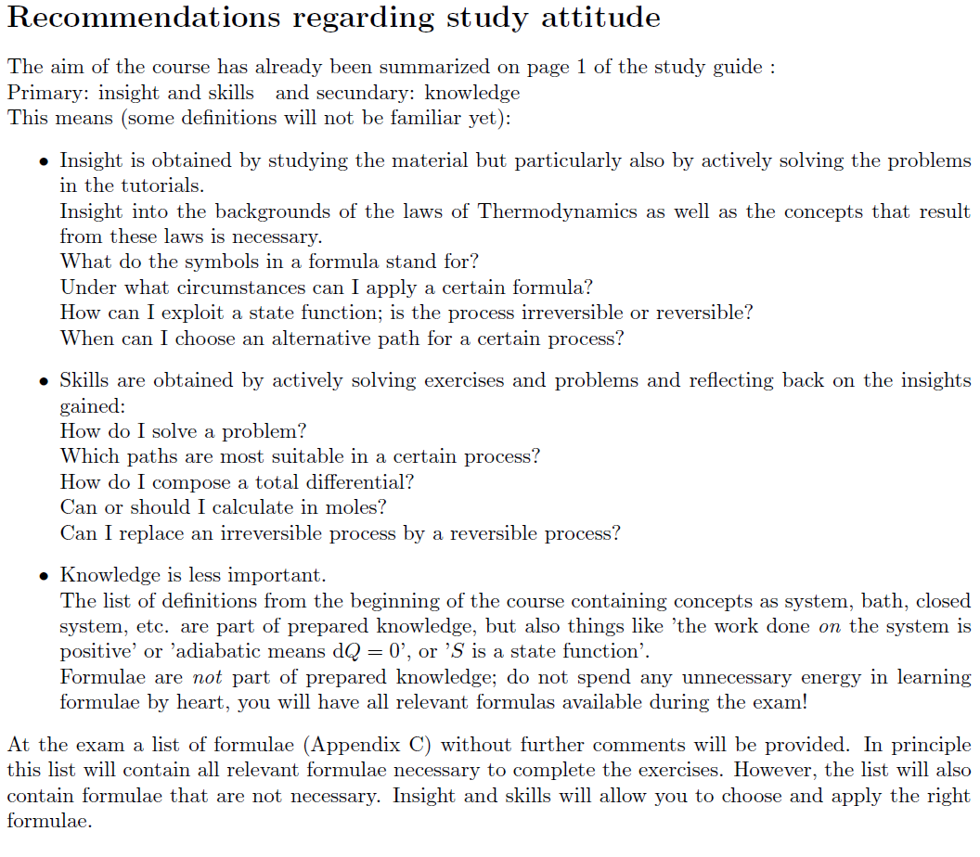

Slide 5
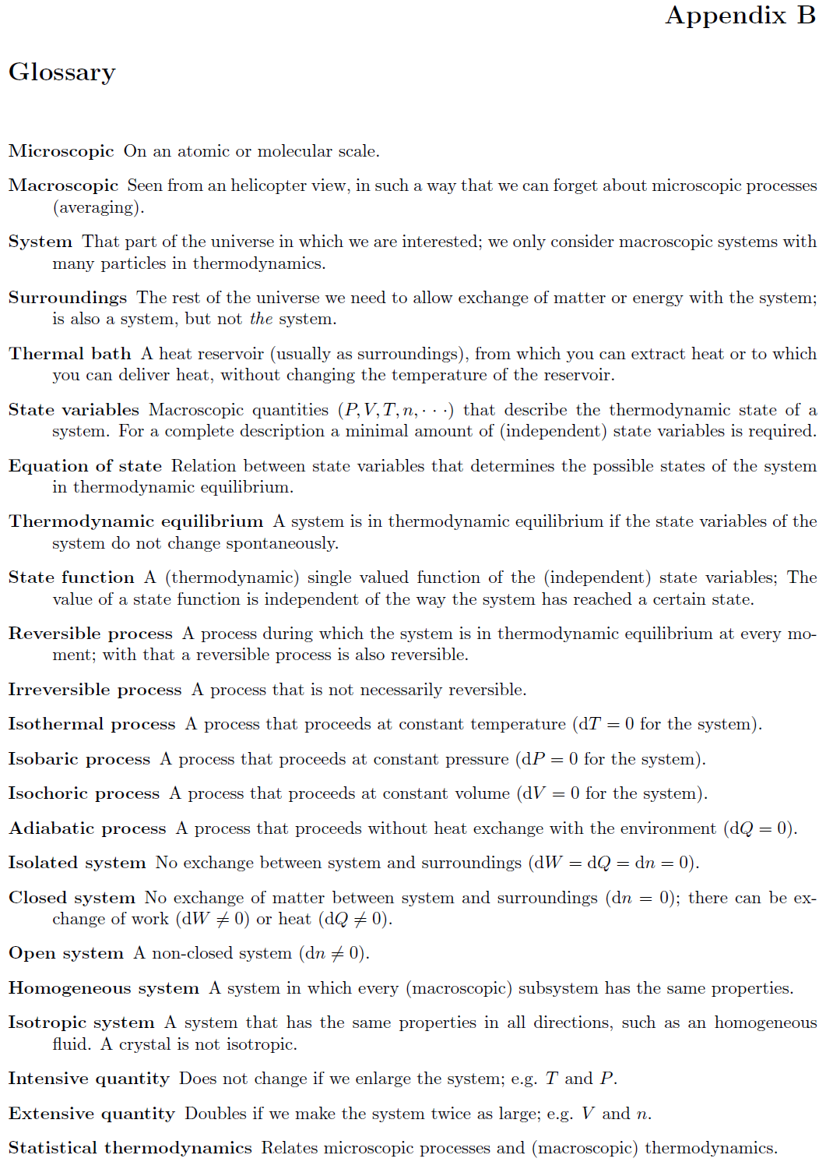

Slide 6
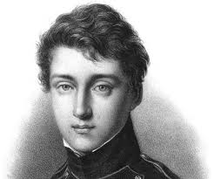
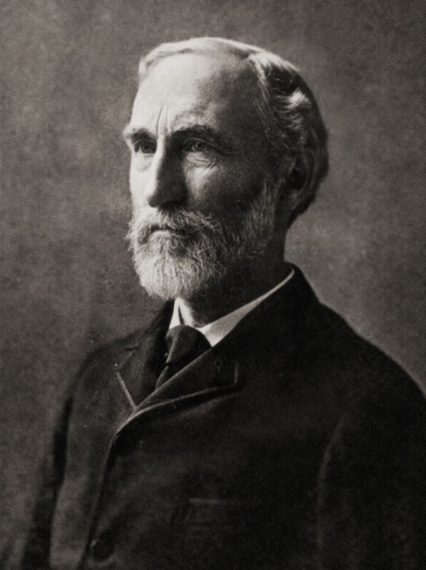
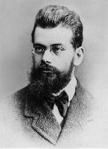
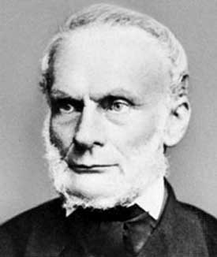
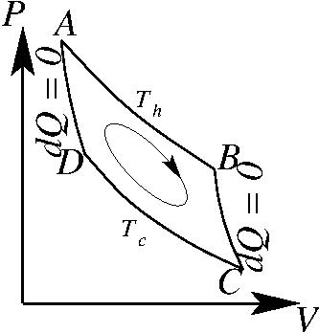
Thermodynamics governs all processes
Carnot 1824
Gibbs 1870
Clausius 1856
Boltzmann 1896
efficiency
free energy
statistical
thermodynamics
entropy

Slide 7
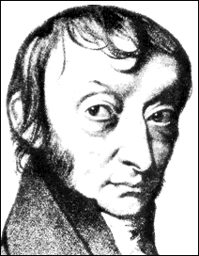
Thermodynamics deals with large numbers
Amadeo Avogadro di Quaregna e Cerreto
(1776-1856)

Slide 8
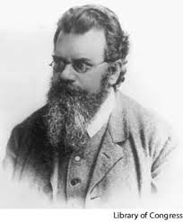
Thermodynamics deals with large numbers
Ludwig Boltzmann (1844-1906)

Slide 9
Thermodynamics
Tells us whether a process will run or not
Tells us in which direction it will run

Slide 10
Thermodynamics
Tells us whether a process will run or not
Tells us in which direction it will run
10
Notes:
10

Slide 11
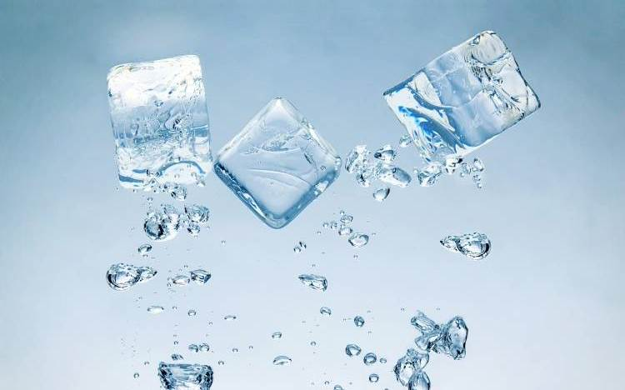
Thermodynamics
Tells us whether a process will run or not
Tells us in which direction it will run
11
Notes:
11

Slide 12
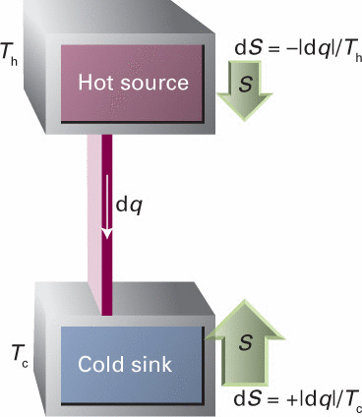
Thermodynamics
Tells us whether a process will run or not
Tells us in which direction it will run
12
Notes:
12

Slide 13
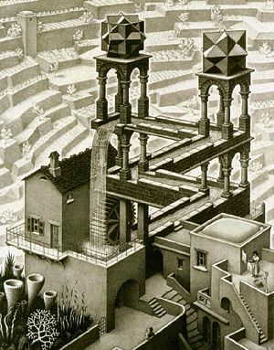
Thermodynamics
Tells us whether a process will run or not
Tells us in which direction it will run
13
Notes:
13

Slide 14
Thermodynamics
Tells us whether a process will run or not
Tells us in which direction it will run
14
Notes:
14

Slide 15
Thermodynamics is about processes

Slide 16
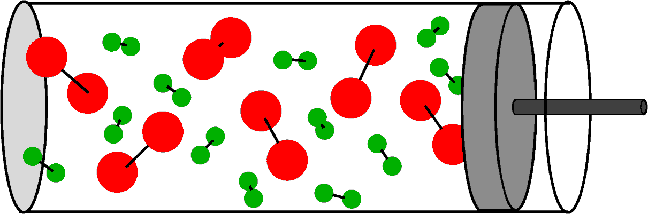
Thermodynamics is about processes

Slide 17
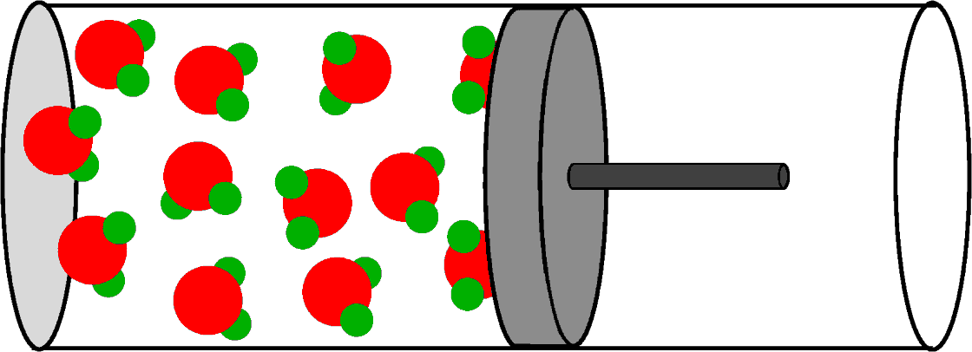
Thermodynamics is about processes
ignition

Slide 18


Thermodynamics is about processes
We have made a few assumptions:
Final state is an equilibrium state
Initinal state is quasi equilibrium state
Initial state
Final state
The gases are perfect gases
The temperature T was constant

Slide 19
Thermodynamics is about processes
We have made a few assumptions:
The gases are perfect gases
Assume
T is constant
Initial state
Final state

Slide 20
Thermodynamics is about processes
We have made a few assumptions:
The gases are perfect gases
Assume
T is constant
Initial state
Final state

Slide 21
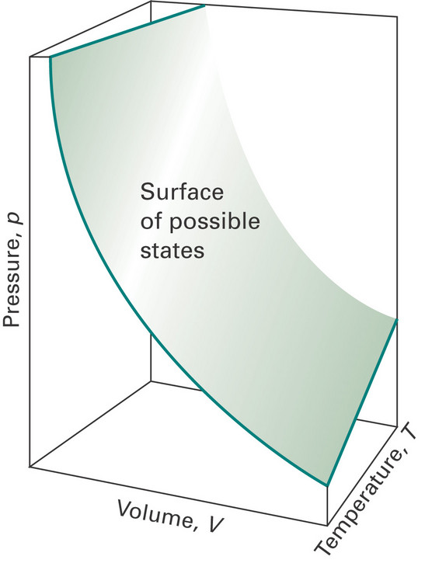
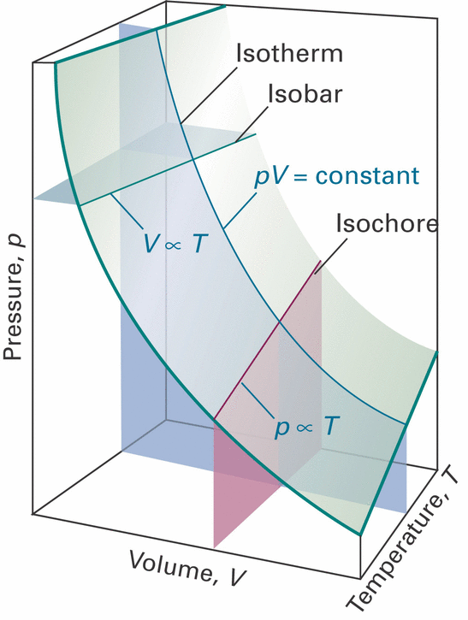
Perfect gases
Equation of state
(only valid in thermodynamic equilibrium)
State variables
Closed system: n constant (dn = 0)

Slide 22
Thermodynamics is about processes
Some new definitions:
Surroundings are external to the system:
Initial state
Final state

Slide 23
Thermodynamics is about processes
Some new definitions:
Surroundings are external to the system:
Initial state
Final state

Slide 24
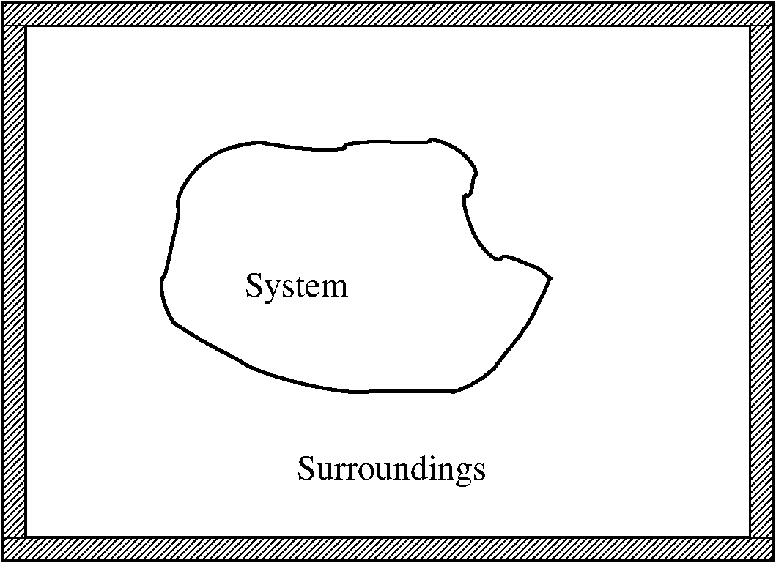
Thermodynamics is about processes
Some new definitions:
Surroundings are external to the system:
Initial state
Final state

Slide 25
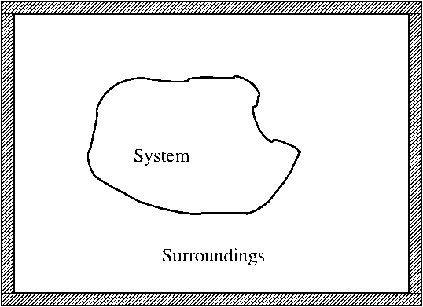
Thermodynamics is about processes
Some new definitions:
Surroundings are external to the system:
Initial state
Final state
P: Pressure
T: Temperature
V: Volume
n: # moles
System

Slide 26
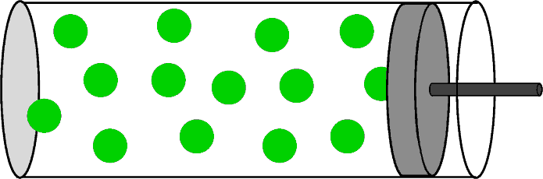
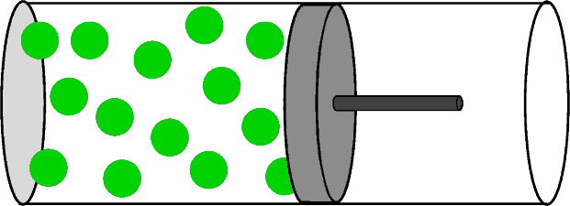
Thermodynamics is about processes
Equilibrium states
Initial state
Final state

Slide 27
Thermodynamics is about processes
Equilibrium states
Initial state
Final state
Closed system

Slide 28
Thermodynamics is about processes
Equilibrium states
Initial state
Final state
Closed system
Perfect gas
For a general process

Slide 29
Thermodynamics is about processes
Equilibrium states
Initial state
Final state
Closed system

Slide 30
Thermodynamics is about processes
Equilibrium states
Initial state
Final state
Closed system

Slide 31
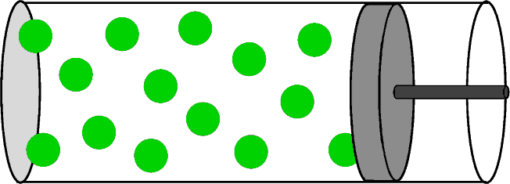
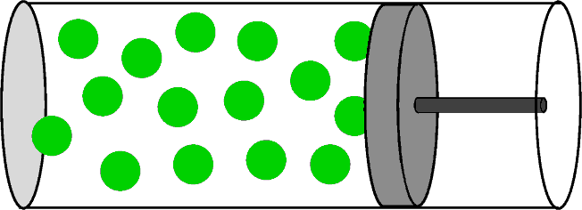
Thermodynamics is about processes
Reversible (very slow) process
slow
slow
slow
Initial state
Intermediate states
Final state
Equilibrium
Equilibrium

Slide 32
Thermodynamics is about processes
Reversible (very slow) process
slow
slow
slow
Initial state
Intermediate states
Final state
Equilibrium
Equilibrium states
Equilibrium
Reversible process

Slide 33
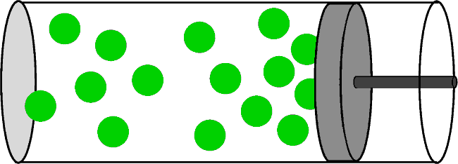
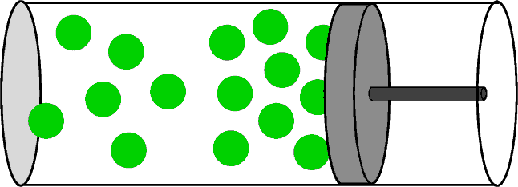
Thermodynamics is about processes
Irreversible (very fast) process
fast
fast
WAIT
Initial state
Intermediate states
Final state
Equilibrium
Equilibrium

Slide 34
Thermodynamics is about processes
Irreversible (very fast) process
fast
fast
WAIT
Initial state
Intermediate states
Final state
Equilibrium
NON-equilibrium states
Equilibrium
Irreversible process

Slide 35
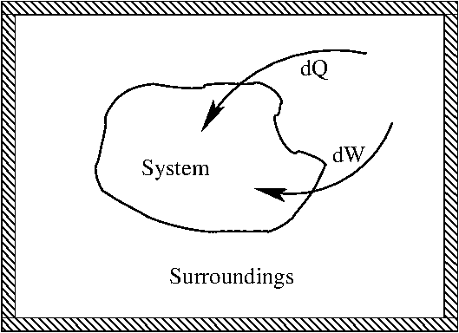
Thermodynamics is about processes
both reversible and irreversible processes

Slide 36
Thermodynamics is based on two laws
These laws are
phenomenological
- First law: conservation of energy
U: internal energy of the system
Q: the heat in the process
W: the work in the process
(any other form of energy
involved in the process)
- Second law: for any spontaneous process
S: entropy of the system
S: related to the heat Q and T

Slide 37
Thermodynamics: First law
- First law: conservation of energy
U: internal energy of the system
Q: the heat in the process
W: the work in the process
(any other form of energy
involved in the process)

Slide 38
Thermodynamics: First law
- First law: conservation of energy
U: internal energy of the system
Q: the heat in the process
W: the work in the process
(any other form of energy
involved in the process)
dU: infinitesimally small change of internal energy of the system
dQ: infinitesimally small change of the heat in the process
dW: infinitesimally small change of the work in the process

Slide 39
Thermodynamics: First law: Example
Reversible or
Irreversible
compression
Equilibrium states
Initial state
Final state
Closed system

Slide 40
Thermodynamics: First law: Example
Reversible or
Irreversible
compression
Equilibrium states
Initial state
Final state
Closed system

Slide 41
Thermodynamics: First law: Example
(A: surface area piston)
Initial state
Final state

Slide 42
Thermodynamics: First law: Example
(A: surface area piston)
Initial state
Final state
dW > 0 for compression (dV < 0)
“W is the work done on the system”

Slide 43
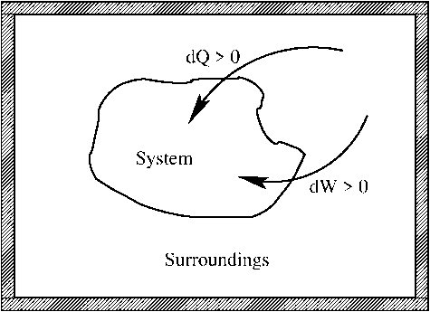
Thermodynamics: First law: Example
Initial state
Final state
dQ > 0 for heat entering the system
“dQ is related to the entropy S and T”

Slide 44
Thermodynamics: First law: Example
To find dU for a general system we need
dQ and dW and the first law
Initial state
Final state
For a perfect gas of atoms
(see page 4-5 Study Guide)

Slide 45
Thermodynamics: First law: Example
Reversible or
Irreversible
compression
Initial state
Equilibrium states
Final state

Slide 46
Thermodynamics: Another example
Reversible or
irreversible
isothermal
expansion
of a
perfect gas
Initial
Final
Isothermal: constant temperature

Slide 47
Thermodynamics: Another example
Reversible or
irreversible
isothermal
expansion
of a
perfect gas
Initial
Final
Isothermal: constant temperature
Closed system: constant amount

Slide 48
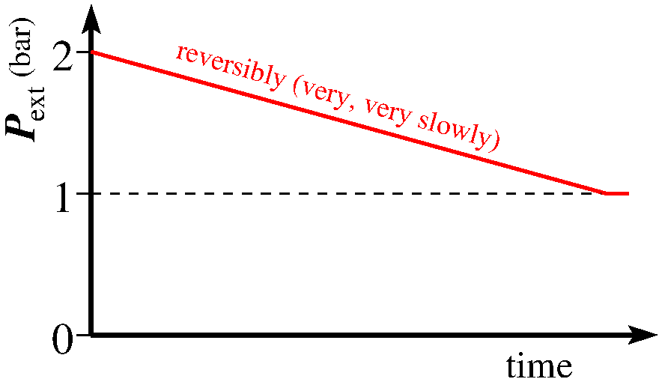
Thermodynamics: Another example
Reversible or
irreversible
isothermal
expansion
of a
perfect gas
Initial
Final

Slide 49
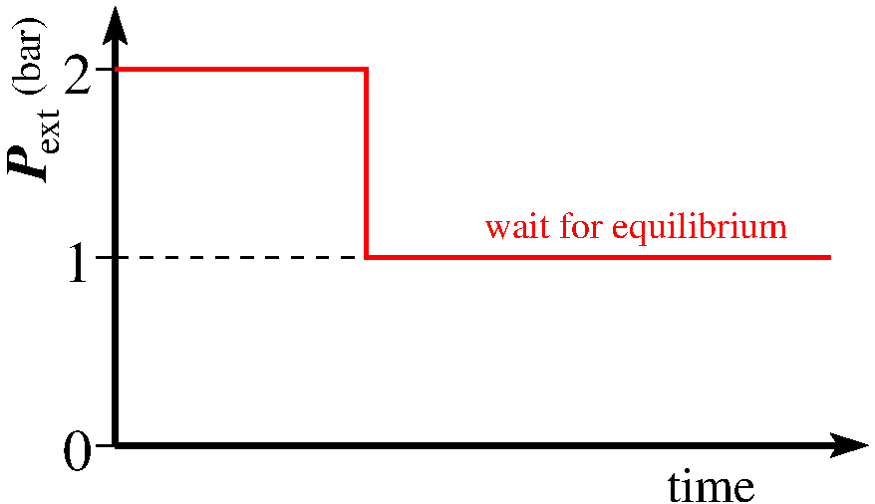
Thermodynamics: Another example
Reversible or
irreversible
isothermal
expansion
of a
perfect gas
Initial
Final

Slide 50
Thermodynamics: Another example
Reversible or
irreversible
isothermal
expansion
of a
perfect gas
Let’s work this out in detail
Initial
Final

Slide 51
Conditional processes
Closed system
Isolated system
P,V,T,n
Isothermal process
Isobaric process
Isochoric process
Adiabatic process

Slide 52
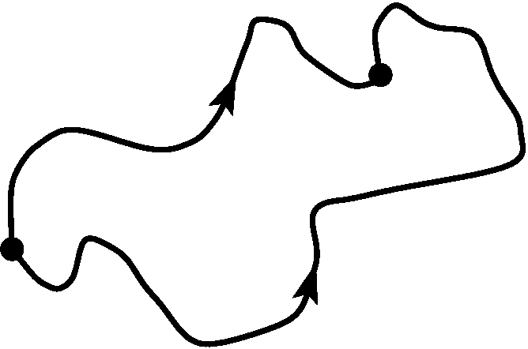
Thermodynamics: First law
- First law: conservation of energy

Slide 53
Thermodynamics: First law
- First law: conservation of energy
According to first law:
U is a state function:
a unique function
of the state variables
however:

Slide 54
Thermodynamics: First law
- First law: conservation of energy
U is a unique function
of the state variables

Slide 55
Thermodynamics: First law
- First law: conservation of energy
U is a unique function
of the state variables
ΔU is independent of path, whether reversible or irreversible

Slide 56
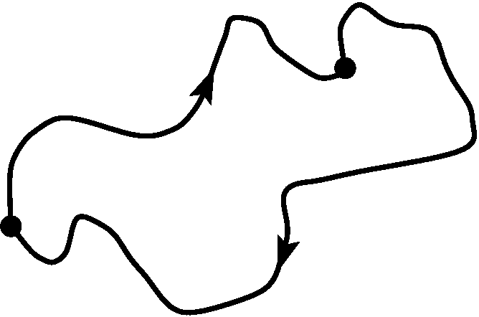
Thermodynamics: First law
- First law: conservation of energy
U is a unique function
of the state variables
Note the different
directions for
paths B and C

Slide 57
Thermodynamics: First law
- First law: conservation of energy
U is a unique function
of the state variables
Note the different
directions for
paths B and C
ΔU = 0 for any loop, whether reversible or irreversible

Slide 58
Thermodynamics is based on two laws
These are phenomenological laws
- First law: conservation of energy
U: internal energy of the system
Q: the heat in the process
W: the work in the process
(Q and W are not state functions)
- Second law: for any spontaneous process
S: entropy of the system

Slide 60
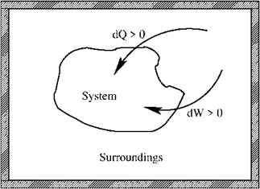
Summary (for a glossery see App. B of SG)
- First law: conservation of energy
Reversible process
- Mechanical work
- Perfect gas
Equation of state
- Perfect atomic gas

Slide 63
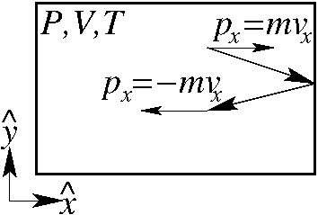
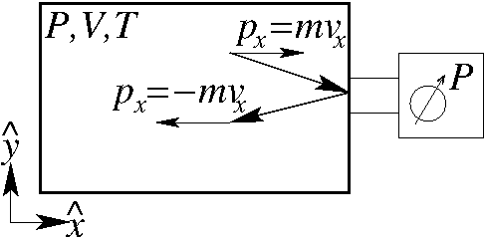
Internal energy U of a perfect gas of N atoms
(Power point version of pages 4-5 of the Study)
{
}

Slide 64
Internal energy U of a perfect gas of N atoms
}
mean velocities
Newton

Slide 65
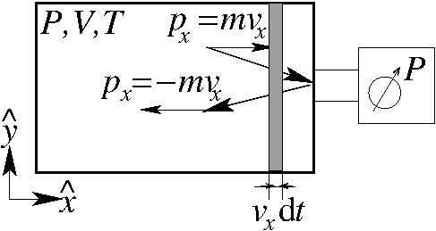
Internal energy U of a perfect gas of N atoms
Number density (# atoms/V)
in dt
atoms have an impact
momentum
transfer
with
so

Slide 66
Internal energy U of a perfect gas of N atoms
}
momentum
pressure
velocity

Slide 67
Internal energy U of a perfect gas of N atoms
}
pressure
internal energy

Slide 68
Internal energy U of a perfect gas atoms
(atoms)
for molecules
also rotational and vibrational contributions:

Slide 69
Thermodynamics

Slide 70
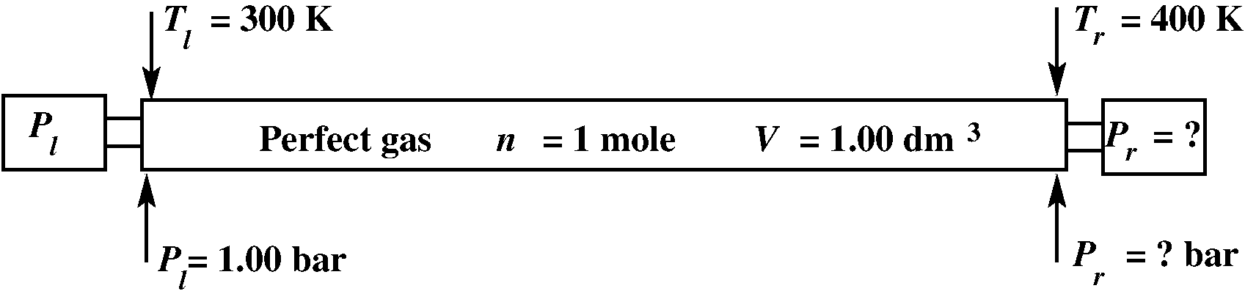
Thermodynamics problem: My Auncle and I
My auncle has a problem:
The problem is what will be the pressure on the right side P_{r} ?

Slide 71
Thermodynamics problem: My Auncle and I
My auncle has a problem:
The problem is what will be the pressure on the right side P_{r} ?
Possible answer 1: P_{r} < P_{l}
Possible answers:
Possible answer 2: P_{r} = P_{l}
Possible answer 3: P_{r} > P_{l}

Slide 72
Thermodynamics problem: My Auncle and I
My auncle has a problem:
The problem is what will be the pressure on the right side P_{r} ?
My auncle says: the temperature is higher, but V is constant, so P_{r} > P_{l} ➔ answer 3
Possible answer 1: P_{r} < P_{l}
Possible answers:
Possible answer 2: P_{r} = P_{l}
Possible answer 3: P_{r} > P_{l}

Slide 73
Thermodynamics problem: My Auncle and I
My auncle has a problem:
The problem is what will be the pressure on the right side P_{r} ?
I (the student) say(s): yes, but for higher T the gas expands and will have locally a smaller density, so a much larger V, so P_{r} < P_{l} ➔ 1
Possible answer 1: P_{r} < P_{l}
Possible answers:
Possible answer 2: P_{r} = P_{l}
Possible answer 3: P_{r} > P_{l}

Slide 74
Thermodynamics problem: My Auncle and I
My auncle has a problem:
The problem is what will be the pressure on the right side P_{r} ?
--My auncle says: the temperature is higher, but V is constant, so P_{r} > P_{l} ➔ answer 3
--I (the student) say(s): yes, but for higher T the gas expands and will have locally a smaller density, so a much larger V, so P_{r} < P_{l} ➔ 1
--Or does your reasoning give P_{r} = P_{l} ➔ answer 2

Slide 75
Thermodynamics

Slide 76
Thermodynamics is about processes
Some new definitions:
Partial pressure P_{i} in a mixture of
perfect or non-perfect gases:
Mole fraction x_{i} of component i :
Initial state
Final state

