Slide 1
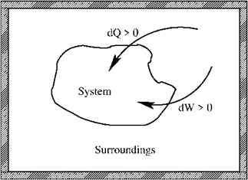
Summary Lecture 1 (glossery: see App. B, SG)
- First law: conservation of energy
Reversible process
- Mechanical work
- Perfect gas
Equation of state
- Perfect atomic gas

Slide 2

Thermodynamics: First law
- First law: conservation of energy
U is a state function
of the state variables
ΔU is independent of the path
whether reversible or irreversible
For any system (not only a perfect gas)

Slide 3
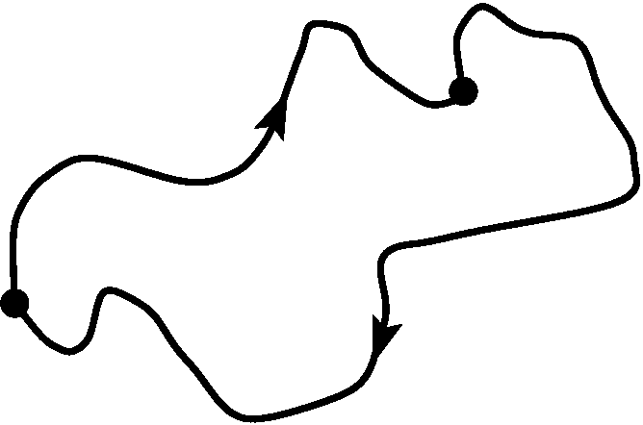
Thermodynamics: First law
- First law: conservation of energy
U is a state function
of the state variables
ΔU = 0 for any loop process
whether reversible or irreversible
For any system (not only a perfect gas)

Slide 4
Thermodynamics is based on two laws
- First law: conservation of energy
- Second law: for any spontaneous process
S: entropy of the system
S: related to the heat Q and T
S_{sur}: entropy of the surroundings

Slide 5
Thermodynamics: need of second law?
- First law: conservation of energy
State function
NOT a state function
- Second law: for any spontaneous process
S: entropy of the system
S: related to the heat Q and T
S_{sur}: entropy of the surroundings

Slide 6
Thermodynamics: need of second law?
- First law: conservation of energy
Path independent
Path dependent
- Second law: for any spontaneous process
S: entropy of the system
S: related to the heat Q and T
S_{sur}: entropy of the surroundings

Slide 7
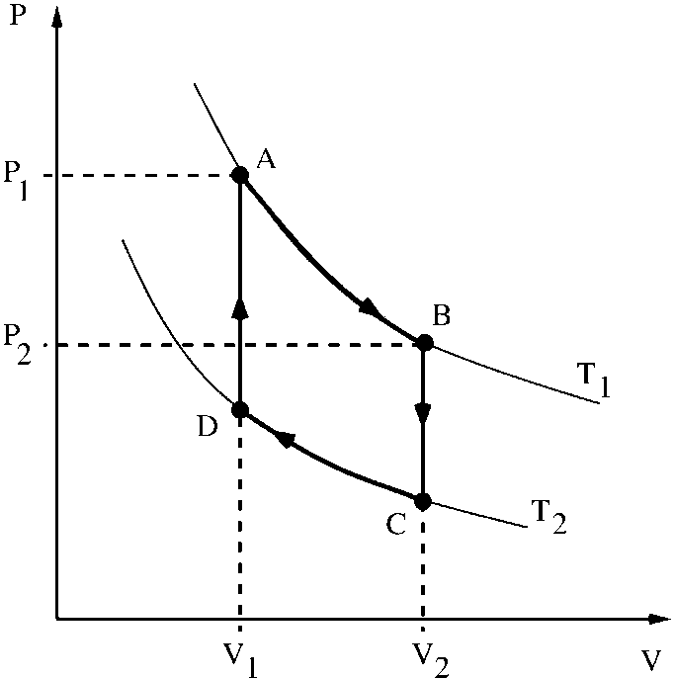
Thermodynamics: need of second law?
Exercise 4
Reversible circular process
for a real (non-perfect) gas
Equation of state
In case B = 0: perfect gas

Slide 8
Thermodynamics: need of second law?
Exercise 4
In case B = 0: perfect gas

Slide 9
Thermodynamics: need of second law?
Exercise 4
In case B = 0: perfect gas
reversible
perfect gas

Slide 10
Thermodynamics: need of second law?
Exercise 4
In case B = 0: perfect gas

Slide 11
Thermodynamics: need of second law?
Exercise 4
In case B = 0: perfect gas

Slide 12
Thermodynamics: need of second law?
Exercise 4
In case B = 0: perfect gas

Slide 13
Thermodynamics: need of second law?
Exercise 4
In case B = 0: perfect gas
isochoric
Isochoric

Slide 14
Thermodynamics: need of second law?
Exercise 4
In case B = 0: perfect gas

Slide 15
Thermodynamics: need of second law?
Exercise 4
In case B = 0: perfect gas

Slide 16
Thermodynamics: need of second law?
Exercise 4
In case B = 0: perfect gas
First law:

Slide 17
Thermodynamics: need of second law?
Exercise 4
In case B = 0: perfect gas
First law:

Slide 18
Thermodynamics: need of second law?
Exercise 4
In case B = 0: perfect gas
Internal energy change
independent of T₁, T₂, V₁, V₂
Work and heat
depend on T₁, T₂, V₁, V₂

Slide 19
Thermodynamics: need of second law?
Exercise 4
In case B = 0: perfect gas
First law holds for all processes, so
also for irreversible processes
Internal energy change
independent of T₁, T₂, V₁, V₂
Work and heat
depend on T₁, T₂, V₁, V₂

Slide 20
Thermodynamics: need of second law?
Exercise 4
In case B = 0: perfect gas
First law for irreversible processes
irreversible process
during process

Slide 21
Thermodynamics: need of second law?
Exercise 4
In case B = 0: perfect gas
Solution was found in entropy S
First law for irreversible processes
irreversible process
during process

Slide 22
Thermodynamics: need of second law?
Solution was found in entropy S
Second law:
for any spontaneous process
only if we define

Slide 23
Thermodynamics: need of second law?
Solution was found in entropy S
Second law:
for any spontaneous process
only if we define
and with that definition
S is a state function,
so path independent
(for a proof see section 3.A.3 of Atkins)

Slide 24
Thermodynamics: need of second law?
Solution was found in entropy S
Second law:
for any spontaneous process
only if we define
and with that definition
S is a state function,
so path independent

Slide 25
Thermodynamics: need of second law?
Intermezzo: this is counter intuitive:
always, so

Slide 26
Thermodynamics: need of second law?
Intermezzo: this is counter intuitive:
always, so
but
Exercise 4
(Reversible process)

Slide 27
Thermodynamics: need of second law?
Intermezzo: this is counter intuitive:
always, so
but
Exercise 4
(Reversible process)
!??

Slide 28
Thermodynamics: need of second law?
Intermezzo: this is counter intuitive:
always, so
but
Exercise 4
(Reversible process)
OK
Answer: we have to be careful:
even if

Slide 29
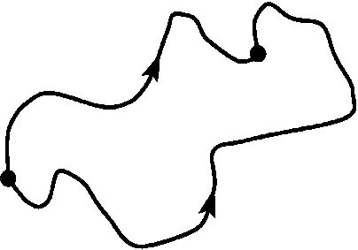
Thermodynamics: need of second law?
Intermezzo: is not counter intuitive:
always, so
but
Exercise 4
(Reversible process)
OK
Moreover:
also T is a
state function

Slide 30
Thermodynamics: need of second law?
Intermezzo: is not counter intuitive:
always, so
but
Exercise 4
(Reversible process)
OK
S and T are
state functions
so also TS is a
state function
Always!

Slide 31
Thermodynamics: need of second law?
Intermezzo: is not counter intuitive:
always, so
but
Exercise 4
(Reversible process)
OK
S and T are
state functions
so also ST is a
state function
Always!

Slide 32
Thermodynamics: need of second law?
Intermezzo: is not counter intuitive:
always, so
Exercise 4
(Reversible process)
Always!

Slide 33
Thermodynamics: need of second law?
Intermezzo: is not counter intuitive:
always, so
Exercise 4
(Reversible process)
in Exercise 4
Always!

Slide 34
Thermodynamics: need of second law?
Intermezzo: is not counter intuitive:
always, so
Exercise 4
(Reversible process)
in Exercise 4
Always!
(and always!)

Slide 35
Thermodynamics: need of second law?
Intermezzo: this is counter intuitive:
Exercise 4

Slide 36

Thermodynamics: need of second law?
So what have learned about entropy?
S is a state function,
so path independent
whether reversible
or irreversible

Slide 37
Thermodynamics: use of second law?
So what have learned about entropy?
S is a state function,
so path independent
whether reversible
or irreversible
To determine ΔS for an irreversible process
we can choose an alternative reversible path
and use

Slide 38
Thermodynamics: use of second law?
So what have learned about entropy?
S is a state function,
so path independent
whether reversible
or irreversible
To determine ΔS for an irreversible process
we can choose an alternative reversible path
and use
ΔS for an isothermal reversible process is not necessarily zero (ex. 4)
ΔS for an adiabatic reversible process is zero

Slide 39
Thermodynamics: use of second law?
Second law:
for any spontaneous process
only if we define

Slide 40
Thermodynamics: use of second law?
Second law:
for any spontaneous process
only if we define

Slide 41
Thermodynamics: use of second law?
Second law:
for any spontaneous process
T_{sur}↔T
only if we define
we choose
the surroundings
to be ideal such that
for any process
Instantaneous and perfect
temperature transfer

Slide 42
Thermodynamics: use of second law?
Second law:
for any spontaneous process
T_{sur}↔T
only if we define
we choose
the surroundings
to be ideal such that
for any process
Instantaneous and perfect
temperature transfer

Slide 43
Thermodynamics: use of second law?
Second law:
for any spontaneous process
^{rev}
dQ_{sur}↔-dQ
only if we define
we choose
the surroundings
to be ideal such that
for any process
Instantaneous and perfect
heat transfer

Slide 44
Thermodynamics: use of second law?
Second law:
for any spontaneous process
^{rev}
dQ_{sur}↔-dQ
only if we define
we choose
the surroundings
to be ideal such that
for any process
Instantaneous and perfect
heat transfer

Slide 45
Thermodynamics: use of second law?
Second law:
for any spontaneous process
only if we define
we choose the surroundings
to be ideal such that
for any process

Slide 46
Thermodynamics: use of second law?
Second law:
for any spontaneous process
only if we define
for any spontaneous process

Slide 47
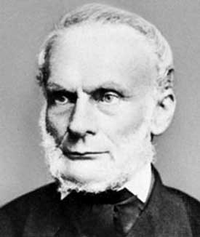
Thermodynamics: use of second law?
Second law:
for any spontaneous process
only if we define
for any spontaneous process
Clausius inequality
Clausius 1856

Slide 48
Thermodynamics: use of second law?
Second law:
for any spontaneous process
only if we define
Clausius inequality

Slide 49
Thermodynamics: use of second law?
Second law:
for any spontaneous process
only if we define
Clausius inequality

Slide 50
Thermodynamics: use of second law?
Second law:
for any spontaneous process
only if we define
Clausius inequality
Reversible process
Irreversible process

Slide 51
Thermodynamics: we use the second law
First law:
Rev. process
Irr. process

Slide 52
Thermodynamics: we use the second law
First law:
Rev. process
Irr. process

Slide 53
Thermodynamics: we use the second law
First law:
Rev. process
Irr. process
rev. process
or irr. process
irr. process
rev. process

Slide 54
Thermodynamics: we use the second law
rev. process
or irr. process
irr. process
rev. process
So ΔU for any irreversible process we can determine with an
alternative reversible process between the same states

Slide 55
Thermodynamics: we use the second law
rev. process
or irr. process
irr. process
rev. process
So ΔU for any irreversible process we can determine with an
alternative reversible process between the same states

Slide 56
Thermodynamics: we use the second law
rev. process
or irr. process
irr. process
rev. process
This is why in most cases we will
use the reversible alternative

Slide 57
Thermodynamics: Conditional processes
Isochoric process:

Slide 58
Thermodynamics: Conditional processes
Isochoric process:
What if we have an isobaric process and
we want such a simple expression ?
define an alternative energy function:
Enthalpy

Slide 59
Thermodynamics: Conditional processes
Isochoric process:
What if we have an isobaric process and
we want such a simple expression ?
define an alternative energy function:
Enthalpy

Slide 60
Thermodynamics: Conditional processes
Isochoric process:
What if we have an isobaric process and
we want such a simple expression ?
define an alternative energy function:
Enthalpy
Isobaric process:
Enthalpy

Slide 61
Thermodynamics: Heat capacity
Isochoric process:
Heat capacity @ constant volume

Slide 62
Thermodynamics: Heat capacity
Isochoric process:
Let’s work this out in detail
Heat capacity @ constant volume
But note:

Slide 63
Thermodynamics: Heat capacities
Isochoric process:
Heat capacity @ constant volume
Isobaric process:
Heat capacity @ constant pressure

Slide 64
Thermodynamics: Conditional processes
Isochoric process:
Isobaric process:
What if we have an isothermal process and
we want such a simple expression ?

Slide 65
Thermodynamics: Conditional processes
Isochoric process:
Isobaric process:
What if we have an isothermal process and
we want such a simple expression ?
define an alternative energy function:
Helmholtz free energy
Isothermal process:
Helmholtz free energy

Slide 66
Thermodynamics: Conditional processes
Isochoric process:
Isobaric process:
Isothermal process:
Isothermal and isochoric process:

Slide 67
Thermodynamics: Conditional processes
Isochoric process:
Isobaric process:
Isothermal process:
Isothermal and isochoric process:
What if we have an isothermal and isobaric process?
define an alternative energy function:
Gibbs free energy
and
and

Slide 68
Thermodynamics: State functions
Internal energy
is a state function
is a state function
is a state function
Helmholtz free energy
is a state function
Also P and V are
state functions
are state functions

Slide 69
Summary Lecture 2

Slide 70
Summary Lecture 2 (second law and entropy)
Second law:
for any spontaneous process
S is a state function, so independent of path
Alternative form: Clausius inequality:
Reversible process
Irreversible process

Slide 71
Summary Lecture 2 (second law and entropy)
Second law:
for any spontaneous process
S is a state function, so independent of path
To determine ΔS for an irreversible process
we can choose an alternative reversible path
and use

Slide 72
Summary Lecture 2 (alternative energy functions)
Internal energy
Enthalpy
State functions
Helmholtz free energy
Gibbs free energy
Heat capacities

