Slide 1
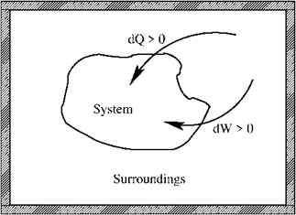
Summary Lecture 1 (glossery: see App. B, SG)
- First law: conservation of energy
Reversible process
- Mechanical work
- Perfect gas
Equation of state
- Perfect atomic gas

Slide 2
Summary Lecture 2 (second law and entropy)
Second law:
for any spontaneous process
S is a state function, so independent of path
Alternative form: Clausius inequality:
Reversible process
Irreversible process

Slide 3
Summary Lecture 2 (alternative energy functions)
Internal energy
Enthalpy
State functions
Helmholtz free energy
Gibbs free energy
(alternative)
reversible
processes
Heat capacities

Slide 4
Lecture 3: Chemical reaction equilibria

Slide 5
Lecture 3: Chemical reaction equilibria
Dissociation reaction of a weak acid:
Chemical equilibrium reaction
Where is the equilibrium state?

Slide 6
Chemical reaction equilibria
Dissociation reaction of a weak acid:
Chemical equilibrium reaction
Where is the equilibrium state?
Depends on P, T, V and n
Depends on equation of state of the system

Slide 7
Chemical reaction equilibria
Dissociation reaction of a weak acid:
Chemical equilibrium reaction
Where is the equilibrium state?
Depends on P, T, V and n
Depends on equation of state of the system
Equation of state of an ionic solution:
probably very difficult

Slide 8
Chemical reaction equilibria
More simple system: equilibrium between perfect gases
equation of state
(perfect gas)
However: we have a mixture of 3 different perfect gases!

Slide 9
Chemical reaction equilibria
More simple system: equilibrium between perfect gases
equation of state
(perfect gas)
However: we have a mixture of 3 different perfect gases!
In equilibrium T, V are the same for all 3 components
(although V will change during progression of the reaction)
Let us choose P_{ext}, T to be constant

Slide 10
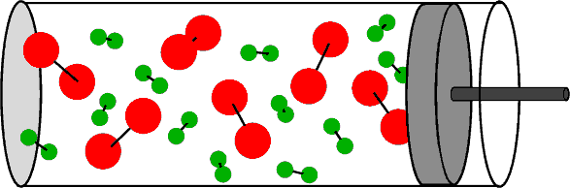
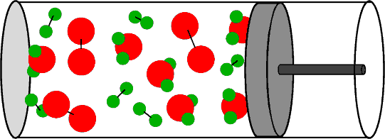
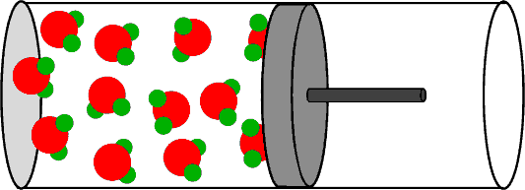
Chemical reaction equilibria
0
0.5
Reaction progression ξ
1
Completely
left
Somewhere
in the middle
Completely
right

Slide 11
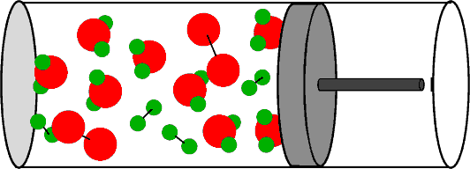
Chemical reaction equilibria
Equilibrium
0
0.5
Reaction progression ξ
1
Completely
left
Somewhere
in the middle
ξ_{eq}
Completely
right

Slide 12
Chemical reaction equilibria
Equilibrium
0
0.5
Reaction progression ξ
1
Completely
left
Somewhere
in the middle
ξ_{eq}
Completely
right

Slide 13
Chemical reaction equilibria
Equilibrium
0
0.5
Reaction progression ξ
1
Completely
left
Somewhere
in the middle
ξ_{eq}
Completely
right
What drives the reaction to the equilibrium state?

Slide 14
Chemical reaction equilibria
What drives the reaction to the equilibrium state?
equilibrium state
Equilibrium ξ_{eq}

Slide 15
Chemical reaction equilibria
What drives the reaction to the equilibrium state?
equilibrium state
We chose P and T to be constant
Equilibrium ξ_{eq}
The Gibbs free energy is the most convenient choice:
But the second law gives even more information

Slide 16
Chemical reaction equilibria
What drives the reaction to the equilibrium state?
Equilibrium ξ_{eq}
Always, so also in non-equilibrium:
?
second law:
for a spontaneous process

Slide 17
Intermezzo: dG in non-equilibrium
Always, so also in non-equilibrium:
at constant pressure:
second law:
for a spontaneous process
In non-equilibrium:
(SG: eq. 46)

Slide 18
Intermezzo: dG in non-equilibrium
Always, so also in non-equilibrium:
In non-equilibrium:
In non-equilibrium:
(SG: eq. 58)
In non-equilibrium:
(SG: eq. 59)

Slide 19
Chemical reaction equilibria
What drives the reaction to the equilibrium state?
equilibrium state
Equilibrium ξ_{eq}
In equilibrium:
In non-equilibrium:

Slide 20
Chemical reaction equilibria
What drives the reaction to the equilibrium state?
equilibrium state
Let’s work this out in detail
Equilibrium ξ_{eq}
In equilibrium:
In non-equilibrium:

Slide 21
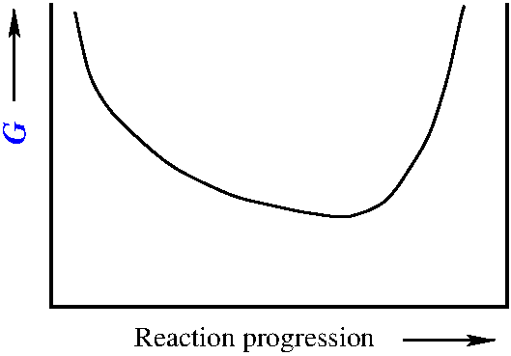
Chemical reaction equilibria
What drives the reaction to the equilibrium state?
Equilibrium state
Equilibrium ξ_{eq}
Energy minimum
T,P
0
Reaction progression ξ
1
ξ_{eq}

Slide 22
Chemical reaction equilibria
Equilibrium state
Equilibrium ξ_{eq}
Energy minimum
T,P
0
Reaction progression ξ
1
ξ_{eq}
so the second law (entropy) drives
the reaction to the equilibrium state

Slide 23
Chemical reaction equilibria
Equilibrium state
Energy minimum
Equilibrium ξ_{eq}
T,P
0
Reaction progression ξ
1
ξ_{eq}
We have overlooked, however, one detail:

Slide 24
Chemical reaction equilibria
Some new definitions:
Partial pressure P_{i} in a mixture of
perfect (or real) gases:
Mole fraction x_{i} of component i :
ξ =0 state
ξ =1 state

Slide 25
Chemical reaction equilibria
Partial pressure
Equilibrium state
Mole fraction
Energy minimum
T,P
0
Reaction progression ξ
1
ξ_{eq}
0<ξ <1 state
with

Slide 26
Chemical reaction equilibria
Partial pressure
Equilibrium state
Mole fraction
Energy minimum
T,P
0
Reaction progression ξ
1
ξ_{eq}
We have additional variables

Slide 27
Chemical reaction equilibria
Partial pressure
Equilibrium state
Mole fraction
Energy minimum
T,P
0
Reaction progression ξ
1
ξ_{eq}

Slide 28
Chemical reaction equilibria
Partial pressure
Equilibrium state
Mole fraction
Energy minimum
T,P
0
Reaction progression ξ
1
ξ_{eq}
µ_{i} : The chemical potential of component i in the mixture

Slide 29
Chemical reaction equilibria: in general
reactants
products
ν_{i} : stoichiometric constant of component i in the reaction equation

Slide 30
Chemical reaction equilibria: in general
reactants
products
products
reactants

Slide 31
Chemical reaction equilibria: in general
reactants
products
products
reactants
products
reactants

Slide 32
Chemical reaction equilibria: in general
products
reactants
example
rewritten:
product
reactants

Slide 33
Chemical reaction equilibria: in general
reactants
products
products
reactants
Products:
Reactants:

Slide 34
Chemical reaction equilibria: in general
Products:
Reactants:

Slide 35
Chemical reaction equilibria: in general
Products:
Reactants:
µ_{i} : The chemical potential of component i

Slide 36
Chemical reaction equilibria: in general
Products:
Reactants:
Equilibrium state
Energy minimum
T,P
0
Reaction progression ξ
1
ξ_{eq}

Slide 37
Chemical reaction equilibria: in general
Products:
Reactants:
Equilibrium state
So, where is the minimum of G
at the chosen T,P ?
Energy minimum
T,P
0
Reaction progression ξ
1
ξ_{eq}

Slide 38
Chemical reaction equilibria: in general
Products:
Reactants:
Equilibrium state
So, where is the minimum of G
at the chosen T,P ?
Energy minimum
T,P
0
Reaction progression ξ
1
ξ_{eq}

Slide 39
Chemical reaction equilibria: in general
Equilibrium:
Equilibrium state
Energy minimum
T,P
0
Reaction progression ξ
1
ξ_{eq}

Slide 40
Chemical reaction equilibria: in general
Equilibrium:
Products:
Reactants:
Equilibrium state
Energy minimum
T,P
0
Reaction progression ξ
1
ξ_{eq}

Slide 41
Chemical reaction equilibria: in general
Equilibrium:
Products:
Reactants:
Equilibrium state
Energy minimum
T,P
0
Reaction progression ξ
1
ξ_{eq}

Slide 42
Chemical reaction equilibria: in general
Equilibrium:
Equilibrium state
Energy minimum
The reaction Gibbs free energy
T,P
0
Reaction progression ξ
1
ξ_{eq}

Slide 43
Chemical reaction equilibria: in general
Equilibrium state
Energy minimum
T,P
0
Reaction progression ξ
1
ξ_{eq}

Slide 44
Chemical reaction equilibria: in general
Δ_{r}G
reaction
Equilibrium state
Energy minimum
T,P
equilibrium
0
Reaction progression ξ
1
ξ_{eq}

Slide 45
Chemical reaction equilibria: in general
Δ_{r}G
reaction
Equilibrium state
Energy minimum
T,P
equilibrium
0
Reaction progression ξ
1
ξ_{eq}

Slide 46
Chemical reaction equilibria: perfect gases
perfect gases
The components are mutually independent
NB: Only for a mixture of perfect gases

Slide 47
Chemical reaction equilibria: perfect gases
Perfect
gases
The components are mutually independent
partial pressure
for each component

Slide 48
Chemical reaction equilibria: perfect gases
Perfect
gases
The components are mutually independent

Slide 49
Chemical reaction equilibria: perfect gases
Perfect
gases
The components are mutually independent
The chemical potential of a
component i with
partial pressure P_{i} in a
perfect gas mixture @ T
P = P^{ϴ} ≡ 1 bar (standard pressure)
component i is pure (as if it is not in a mixture)
ϴ

Slide 50
Chemical reaction equilibria: perfect gases
Equilibrium state
The reaction Gibbs free energy
Energy minimum
T,P
0
Reaction progression ξ
1
The chemical potential of a
perfect gas component i
ξ_{eq}

Slide 51
Chemical reaction equilibria: perfect gases
Equilibrium state
The reaction Gibbs free energy
Energy minimum
T,P
0
Reaction progression ξ
1
The chemical potential of
perfect gas component i
ξ_{eq}

Slide 52
Chemical reaction equilibria: perfect gases
Equilibrium state
Energy minimum
T,P
0
Reaction progression ξ
1
Reaction quotient
for perfect gases
ξ_{eq}

Slide 53
Chemical reaction equilibria: perfect gases
Let’s work this out in detail
Equilibrium state
Energy minimum
T,P
0
Reaction progression ξ
1
Reaction quotient
for perfect gases
ξ_{eq}

Slide 54
Chemical reaction equilibria: perfect gases
Equilibrium state
Reaction quotient
for perfect gases
Energy minimum
T,P
0
Reaction progression ξ
1
ξ_{eq}

Slide 55
Chemical reaction equilibria: perfect gases
Equilibrium state
Reaction quotient
for perfect gases
Energy minimum
T,P
0
Reaction progression ξ
1
ξ_{eq}
Equilibrium ξ_{eq}
Equilibrium constant: K

Slide 56
Chemical reaction equilibria: perfect gases
Reaction quotient
for perfect gases
Equilibrium state
Energy minimum
T,P
Non-equilibrium ξ
0
Reaction progression ξ
1
ξ_{eq}
Equilibrium ξ_{eq}
Equilibrium constant: K

Slide 57
Chemical reaction equilibria: perfect gases
Equilibrium constant: K
Equilibrium state
equilibrium
reaction quotient
for perfect gases
Energy minimum
T,P
0
Reaction progression ξ
1
ξ_{eq}

Slide 58
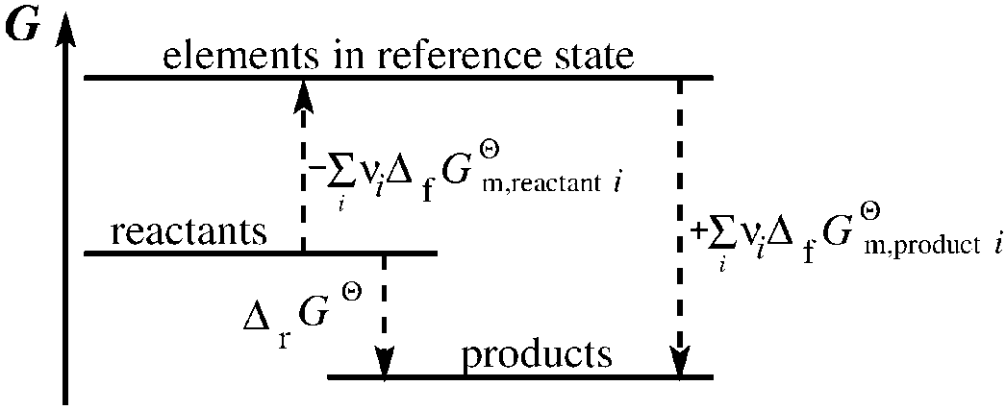
Chemical reaction equilibria: perfect gases
with
Standard formation molar Gibbs free energy

Slide 59
Chemical reaction equilibria: perfect gases
with
Standard formation molar Gibbs free energy

Slide 60
Chemical reaction equilibria: perfect gases
with
Standard formation molar Gibbs free energy
Reference states (T):

Slide 61
Chemical reaction equilibria: perfect gases
with
Standard formation molar Gibbs free energy
Reference states (T):

Slide 62
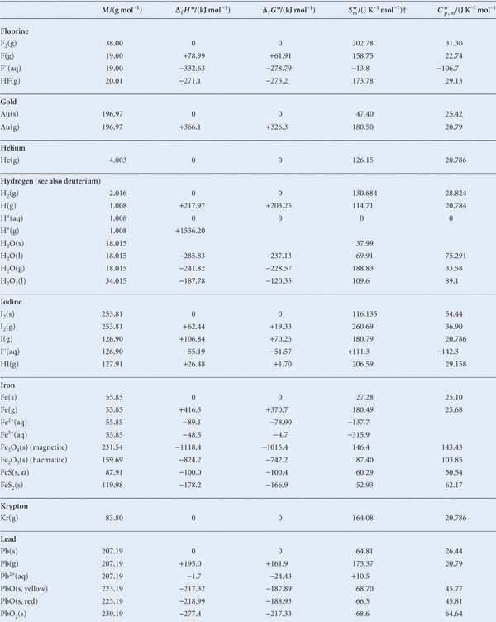
Chemical reaction equilibria: perfect gases
← specified @ 298 K

Slide 63
Chemical reaction equilibria: perfect gases
← specified @ 298 K

Slide 64
Chemical reaction equilibria: example
Elements in
reference
states (T)
product
reactants
As expected: completely on the right hand side

Slide 65
Chemical reaction equilibria: perfect gases
Elements in
reference
states (T)
(tables refer to 298 K)
at constant, chosen T
and assume that
are weakly dependent on T

Slide 66
Chemical reaction equilibria: perfect gases
Elements in
reference
states (T)
(tables: )
assume that
are weakly dependent on T

Slide 67
Chemical reaction equilibria: perfect gases
Elements in
reference
states (T)
At constant, chosen T

Slide 68
Chemical reaction equilibria: perfect gases
Elements in
reference
states (T)
assume that
are weakly dependent on T

Slide 69
Chemical reaction equilibria: example
product
reactants
A little bit less ‘’completely on the right hand side’’

Slide 70
Summary Lecture 3 (chemical equilibria)

Slide 71
Summary Lecture 3 (chemical equilibria)
Second law→
Δ_{r}G
reaction
Equilibrium state
Energy minimum
T,P
0
Reaction progression ξ
1
ξ_{eq}
Equilibrium constant

Slide 72
Summary Lecture 3 (formation energies)
At constant, chosen T
For all ellements in their reference states at T
For all ellements in their reference states at T
For gaseous mixtures
For perfect gas mixtures
Mole fraction
Partial
pressure

