Slide 1
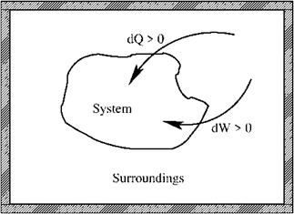
Summary Lecture 1 (glossery: see App. B, SG)
- First law: conservation of energy
Reversible process
- Mechanical work
- Perfect gas
Equation of state
- Perfect atomic gas

Slide 2
Summary Lecture 2 (second law and entropy)
Second law:
for any spontaneous process
S is a state function, so independent of path
Alternative form: Clausius inequality:
Reversible process
Irreversible process

Slide 3
Summary Lecture 2 (alternative energy functions)
Internal energy
Enthalpy
State functions
Helmholtz free energy
Gibbs free energy
Heat capacities

Slide 4
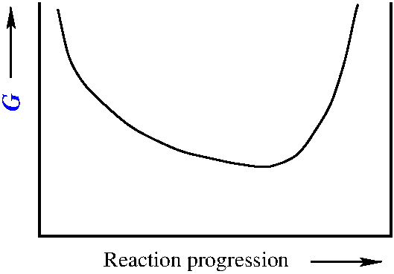
Summary Lecture 3 (chemical equilibria)
Second law→
Δ_{r}G
reaction
Equilibrium state
Energy minimum
T,P
0
Reaction progression ξ
1
ξ_{eq}

Slide 5
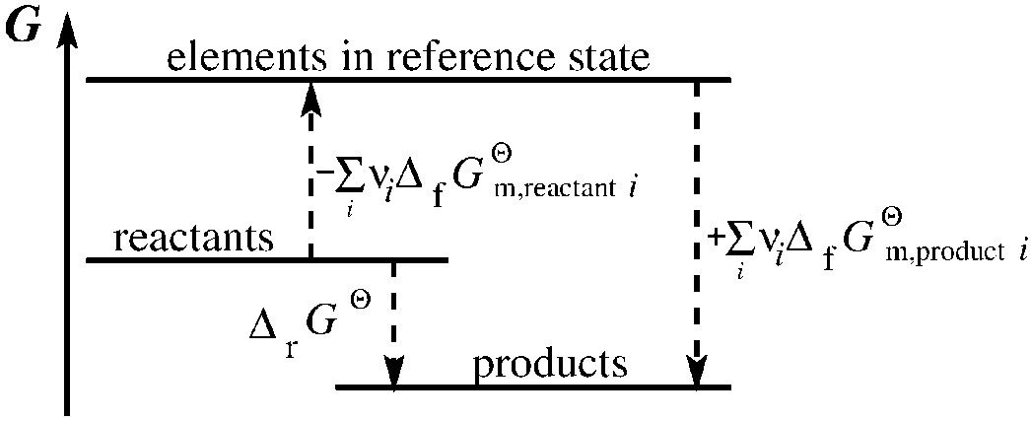
Summary Lecture 3 (formation energies)
At constant, chosen T
For all elements in their reference states at T
For all elements in their reference states at T
For gaseous mixtures
For perfect gas mixtures
Mole fraction
Partial
pressure

Slide 6
Summary Lecture 3 (chemical equilibria)
Second law→
(for any system)
Non-quilibrium ξ
Equilibrium ξ_{eq}
Equilibrium constant: K
P = P^{ϴ} ≡ 1 bar (standard pressure)
component i is pure (as if it is not in a mixture)
ϴ

Slide 7
Lecture 4: Chemical reaction equilibria cont^{d}

Slide 8
Chemical reaction equilibria: activities
Equilibrium state
Δ_{r}G
reaction
Energy minimum
T,P
0
Reaction progression ξ
1
ξ_{eq}
For perfect gas mixtures

Slide 9
Chemical reaction equilibria: activities
Equilibrium state
Δ_{r}G
reaction
Energy minimum
T,P
0
Reaction progression ξ
1
ξ_{eq}
For perfect gas mixtures
What to do with real systems?

Slide 10
Chemical reaction equilibria: activities
For perfect gas mixtures
What to do with real systems?

Slide 11
Chemical reaction equilibria: activities
For perfect gas mixtures
The chemical potential of
perfect gas component i
What to do with real systems?

Slide 12
Chemical reaction equilibria: activities
What is the chemical potential of a component i in real systems?

Slide 13
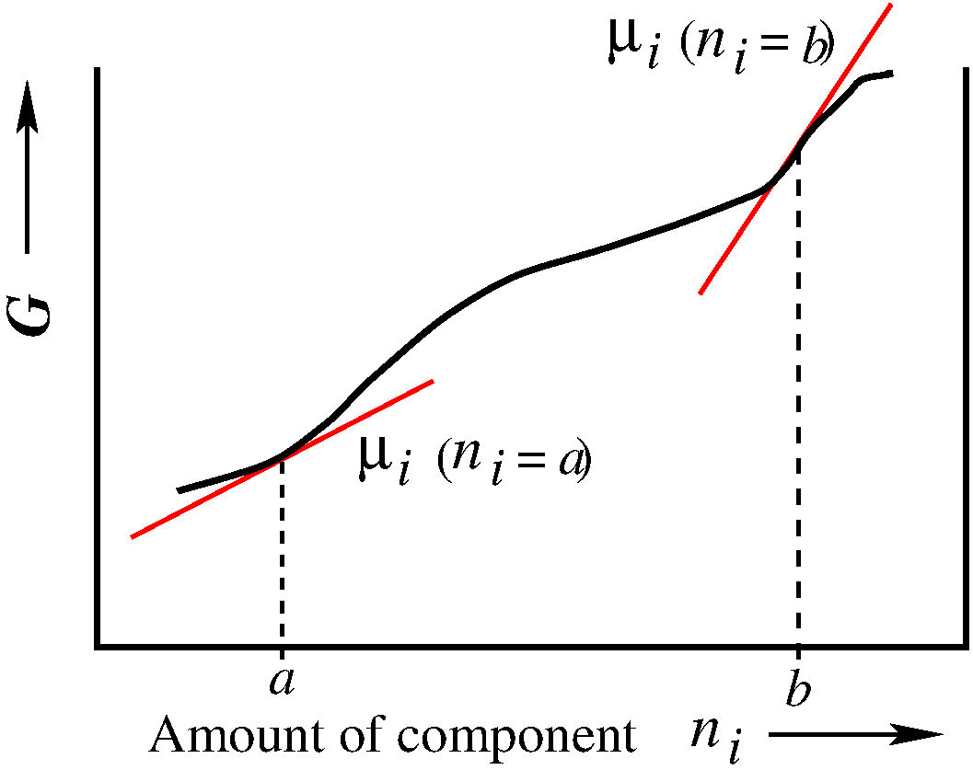
Chemical reaction equilibria: activities
What is the chemical potential of a component i in real systems?
real gases
liquids
solids
solutions
molecules not independent;
also have interactions other
than hard sphere collisions
Real systems

Slide 14
Chemical reaction equilibria: activities
The chemical potential of
perfect gas component i
real gases
liquids
solids
solutions
molecules not independent;
also have interactions other
than hard sphere collisions
Real systems
a_{i} is the activity of component i in a solution or mixture

Slide 15
Chemical reaction equilibria: activities
Real systems

Slide 16
Chemical reaction equilibria: activities
Real systems
Equilibrium constant
Equilibrium

Slide 17
Chemical reaction equilibria: activities
Real systems
Equilibrium constant
Equilibrium

Slide 18
Chemical reaction equilibria: activities
Real systems
P = P^{ϴ} ≡ 1 bar (standard pressure)
component i is pure (as if it is not in a mixture)
ϴ

Slide 19
Chemical reaction equilibria: activities
Real systems
P = P^{ϴ} ≡ 1 bar (standard pressure)
component i is pure (as if it is not in a mixture)
ϴ
is independent of interactions in real systems

Slide 20
Chemical reaction equilibria: activities
Real systems
a_{i} is the activity of component i in a solution or mixture

Slide 21
Chemical reaction equilibria: activities
Real systems
For perfect gas mixtures
For perfect gas mixtures
a_{i} is the activity of component i in a solution or mixture

Slide 22
Chemical reaction equilibria: activities
Real systems
For perfect gas mixtures
For perfect gas mixtures
Liquids and solids
are virtually
incompressible
For pure liquids
For pure solids

Slide 23
Chemical reaction equilibria: activities
Real systems
For perfect gas mixtures
For perfect gas mixtures
So what
about
solutions?
Liquids and solids
are virtually
incompressible
For pure liquids
For pure solids

Slide 24
Chemical reaction equilibria: Electrochemistry
For perfect gas mixtures
For pure liquids
For pure solids
So what
about
solutions?
Neutral solutions (Lecture 5)
Electrolytes (ions): Electrochemistry

Slide 25
Chemical reaction equilibria: Electrochemistry
Electrochemistry: redox reactions; a few concepts:
Reduction
halfreaction
Oxidizing agent + νe⁻ → Reducing agent
Oxidant + νe⁻ → Reductant
Ox + νe⁻ → Red
redox reactions: electron transfer

Slide 26
Chemical reaction equilibria: Electrochemistry
Electrochemistry: redox reactions; a few concepts:
Reduction
halfreaction
Oxidizing agent + νe⁻ → Reducing agent
Oxidant + νe⁻ → Reductant
Ox + νe⁻ → Red
Oxidation
halfreaction
Reducing agent → Oxidizing agent + νe⁻
Reductant → Oxidant + νe⁻
Red → Ox + νe⁻

Slide 27
Chemical reaction equilibria: Electrochemistry
Reduction
halfreactions
Oxidizing agent + νe⁻ → Reducing agent
Oxidant + νe⁻ → Reductant
Ox + νe⁻ → Red
Total reaction
Ox₁ + Red₂ + νe⁻ → Red₁ + Ox₂ + νe⁻
Ox₁ + Red₂ → Red₁ + Ox₂

Slide 28
Chemical reaction equilibria: Electrochemistry
Reduction
halfreactions
Oxidizing agent + νe⁻ → Reducing agent
Oxidant + νe⁻ → Reductant
Ox + νe⁻ → Red
Total reaction
Ox₁ + Red₂ + νe⁻ → Red₁ + Ox₂ + νe⁻
Ox₁ + Red₂ → Red₁ + Ox₂
Reduction
1
Oxidation
2

Slide 29
Chemical reaction equilibria: Electrochemistry
Reduction
halfreactions
Oxidizing agent + νe⁻ → Reducing agent
Oxidant + νe⁻ → Reductant
Ox + νe⁻ → Red
Total reaction
Ox₁ + Red₂ + νe⁻ → Red₁ + Ox₂ + νe⁻
Ox₁ + Red₂ → Red₁ + Ox₂
Reduction
1
5x
Oxidation
2
+

Slide 30
Chemical reaction equilibria: Electrochemistry
Ox₁ + Red₂ → Red₁ + Ox₂
But what about the reverse reaction?
Red₁ + Ox₂ → Ox₁ + Red₂
Ox₂ + Red₁ → Red₂ + Ox₁
Electrochemical Equilibrium reaction
→ Will it run spontaneously to the right or to the left?
→ Where is the equilibrium?

Slide 31
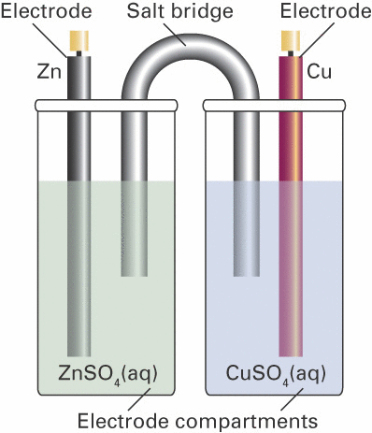
Chemical reaction equilibria: Electrochemistry
-
Voltage V represents a
‘driving force’ like Δ_{r}G
V
+
Pt
Pt
Equilibrium state
Energy minimum
T,P
0
Reaction progression ξ
1
ξ_{eq}

Slide 32
Chemical reaction equilibria: Electrochemistry
-
Voltage V represents a
‘driving force’ like Δ_{r}G
V
+
Pt
Pt
Equilibrium:
Relation between V and Δ_{r}G

Slide 33
Chemical reaction equilibria: Electrochemistry
-
Voltage V represents a
‘driving force’ like Δ_{r}G
V
+
Pt
Pt
Let’s work this out in detail
Equilibrium:
Relation between V and Δ_{r}G

Slide 34
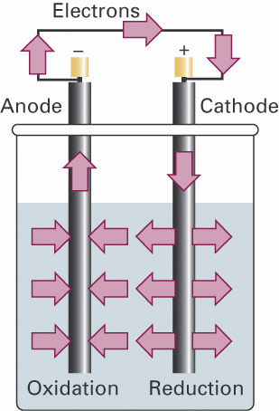
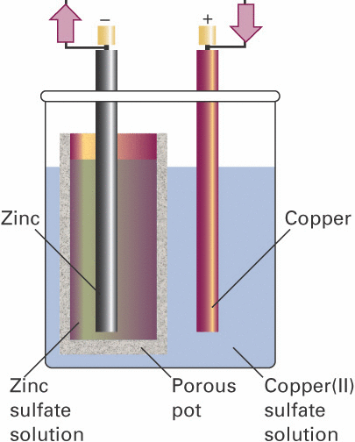
Chemical reaction equilibria: Electrochemistry
Electrochemical cells

Slide 35
Chemical reaction equilibria: Electrochemistry
Equilibrium:
Equilibrium:

Slide 36
Chemical reaction equilibria: Electrochemistry
Nernst equation

Slide 37
Chemical reaction equilibria: Electrochemistry
Nernst equation
reaction
-
E
+
Equilibrium state
Pt
Pt
Energy minimum
T,P
0
Reaction progression ξ
1
ξ_{eq}

Slide 38
Chemical reaction equilibria: Electrochemistry
Nernst equation
with

Slide 39
Chemical reaction equilibria: Electrochemistry
Nernst equation
with
Nernst also holds for half reactions
Note: reduction half reaction

Slide 40
Chemical reaction equilibria: Electrochemistry
Nernst also holds for half reactions
-
Note: reduction half reactions

Slide 41
Chemical reaction equilibria: Electrochemistry
Nernst also holds for half reactions
-
Note: reduction half reactions

Slide 42
Chemical reaction equilibria: Electrochemistry
Nernst also holds for half reactions
-
Note: reduction half reactions
-

Slide 43
Chemical reaction equilibria: Electrochemistry
Nernst also holds for half reactions
-
Note: reduction half reactions

Slide 44
Chemical reaction equilibria: Electrochemistry
Nernst also holds for half reactions
-
Note: reduction half reactions

Slide 45
Chemical reaction equilibria: Electrochemistry
Nernst also holds for half reactions
Standard electrochemical potentials of
redox couples are in tables as
reduction half reactions

Slide 46
Chemical reaction equilibria: Electrochemistry
Nernst also holds for half reactions
Standard electrochemical potentials of
redox couples are in tables as
reduction half reactions
- sign because we need a reduction and an oxidation half reaction

Slide 47
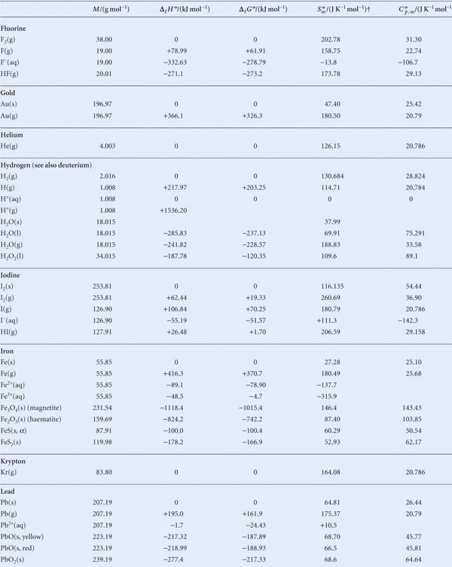
Chemical reaction equilibria: ions in solution
Standard
thermodynamic
data
(@ 298K)
(Ed.11: Table 2C.7)

Slide 48
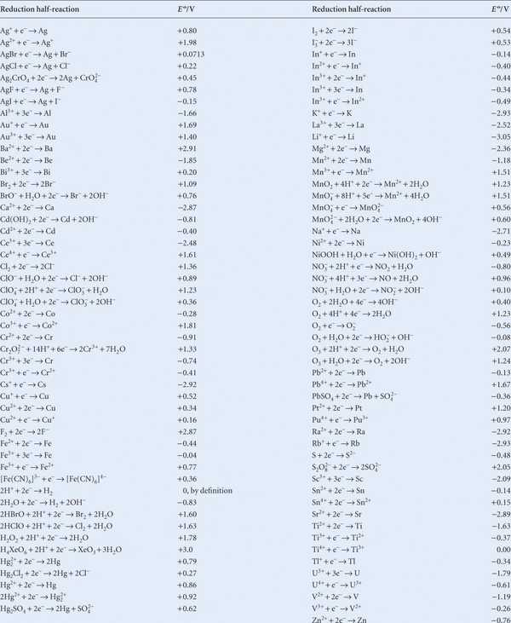
Standard
electrochemical
potentials E^{Θ}
of redox
couples
(@ 298K)
alphabetical order
(Ed.11:
Table 6D.1b)
for all T(aq)

Slide 49
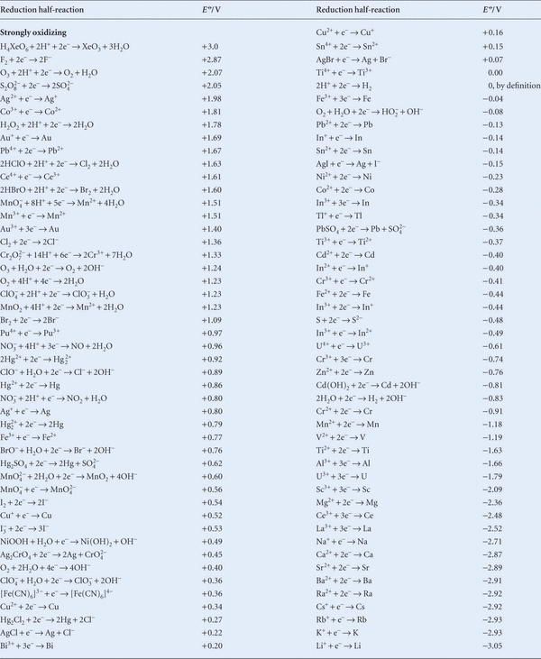
Standard
electrochemical
potentials E^{Θ}
of redox
couples
(@ 298K)
electrochemical
order
(Ed.11:
Table 6D.1a)

Slide 50
Chemical reaction equilibria: Electrochemistry

Slide 51
Chemical reaction equilibria: Electrochemistry

Slide 52
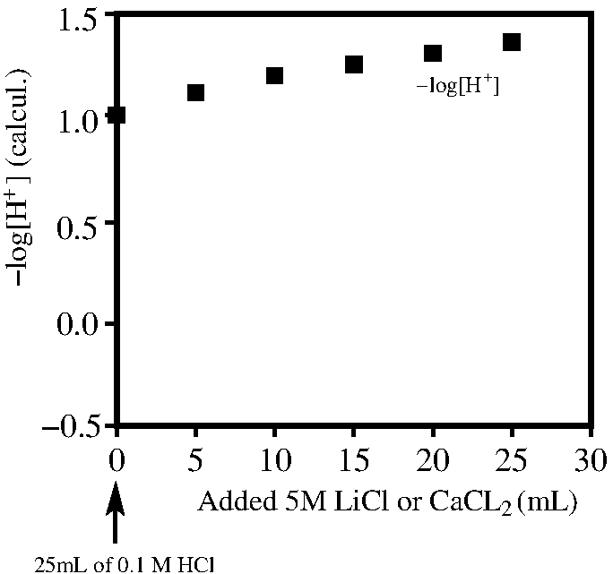
Chemical reaction equilibria: Electrochemistry
Why pH is defined via the activity

Slide 53
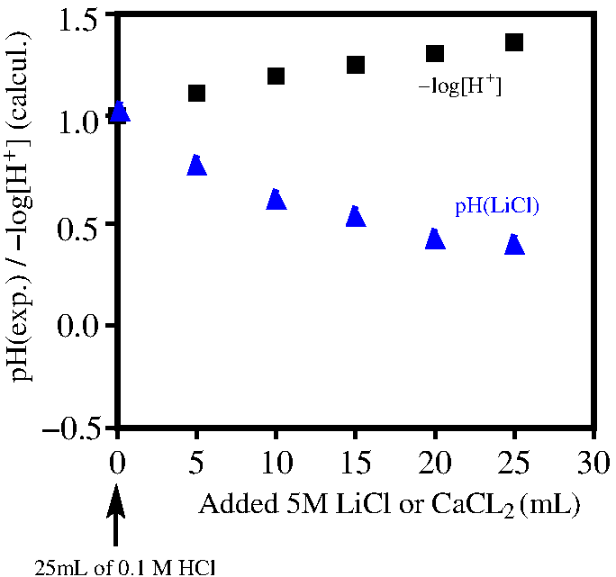
Chemical reaction equilibria: Electrochemistry
Why pH is defined via the activity

Slide 54
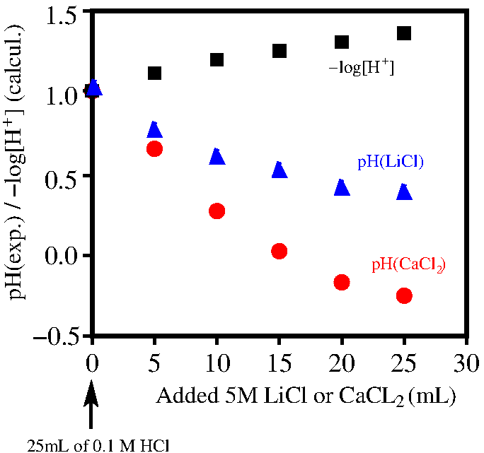
Chemical reaction equilibria: Electrochemistry
Why pH is defined via the activity

Slide 55
Chemical reaction equilibria: Electrochemistry
Why pH is defined via the activity
Definition of activity:

Slide 56
Chemical reaction equilibria: Electrochemistry
Tables

Slide 57
Chemical reaction equilibria: Electrochemistry
Very dilute solutions→a_{H2O}≈1
Very dilute solutions→a_{i}≈[i]

Slide 58
Chemical reaction equilibria: Electrochemistry
Activity as an effective concentration
ideal or dilute
behaviour
deviation
from ideal
activity coefficient on the concentration scale
Molarity (mol/L):

Slide 59
Chemical reaction equilibria: Electrochemistry
Activity as an effective concentration
Molarity (mol/L)
Molality (mol/kg)
Mole fraction ( )
example

Slide 60
Summary Lecture 4 (chemical equilibria cont^{d})

Slide 61
Summary Lecture 4 (activity)
For perfect gas mixtures
For pure liquids
For pure solids
For general systems:

Slide 62
Summary Lecture 4 (electrochemistry)
Nernst equation
reaction
-
E
+
Equilibrium state
Pt
Pt
Energy minimum
T,P
0
Reaction progression ξ
1
ξ_{eq}

