Slide 1
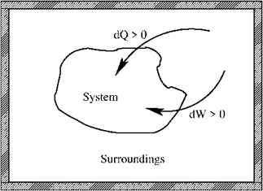
Summary Lecture 1 (glossery: see App. B, SG)
- First law: conservation of energy
Reversible process
- Mechanical work
- Perfect gas
Equation of state
- Perfect atomic gas

Slide 2
Summary Lecture 2 (second law and entropy)
Second law:
for any spontaneous process
S is a state function, so independent of path
Alternative form: Clausius inequality:
Reversible process
Irreversible process

Slide 3
Summary Lecture 2 (alternative energy functions)
Internal energy
Enthalpy
State functions
Helmholtz free energy
Gibbs free energy
Heat capacities

Slide 4
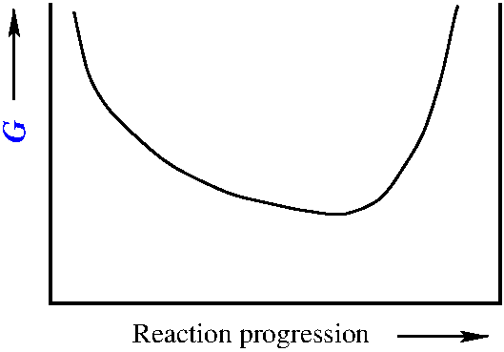
Summary Lecture 3 (chemical equilibria)
Second law→
Equilibrium state
Δ_{r}G
reaction
Energy minimum
T,P
0
Reaction progression ξ
1
ξ_{eq}

Slide 5
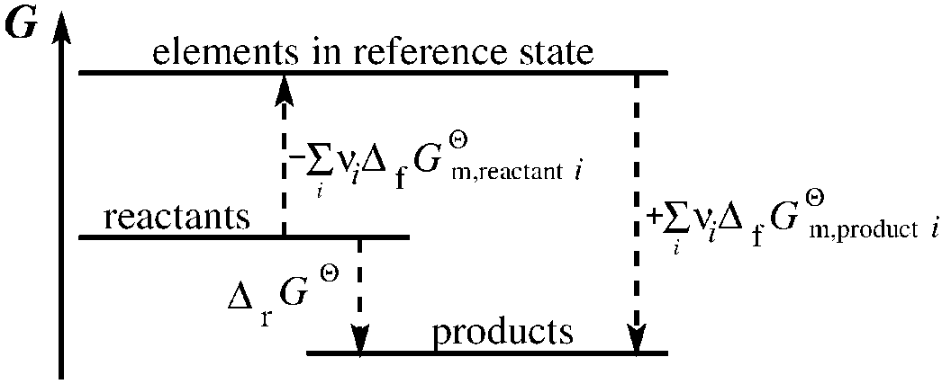
Summary Lecture 3 (formation energies)
At constant, chosen T
For all ellements in their reference states at T
For all ellements in their reference states at T
For gaseous mixtures
For perfect gas mixtures
Mole fraction
Partial
pressure

Slide 6
Summary Lecture 4 (activity)
For general systems:
For perfect gas mixtures
For pure liquids
For pure solids
with
with

Slide 7
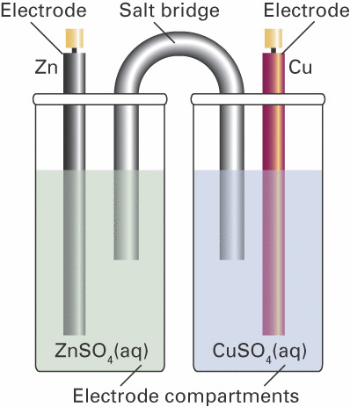
Summary Lecture 4 (electrochemistry)
Nernst equation
reaction
-
E
+
Equilibrium state
Pt
Pt
Energy minimum
T,P
0
Reaction progression ξ
1
ξ_{eq}

Slide 8
Summary Lecture 4 (electrochemistry)

Slide 9
Lecture 5: Solutions and colligative processes

Slide 10
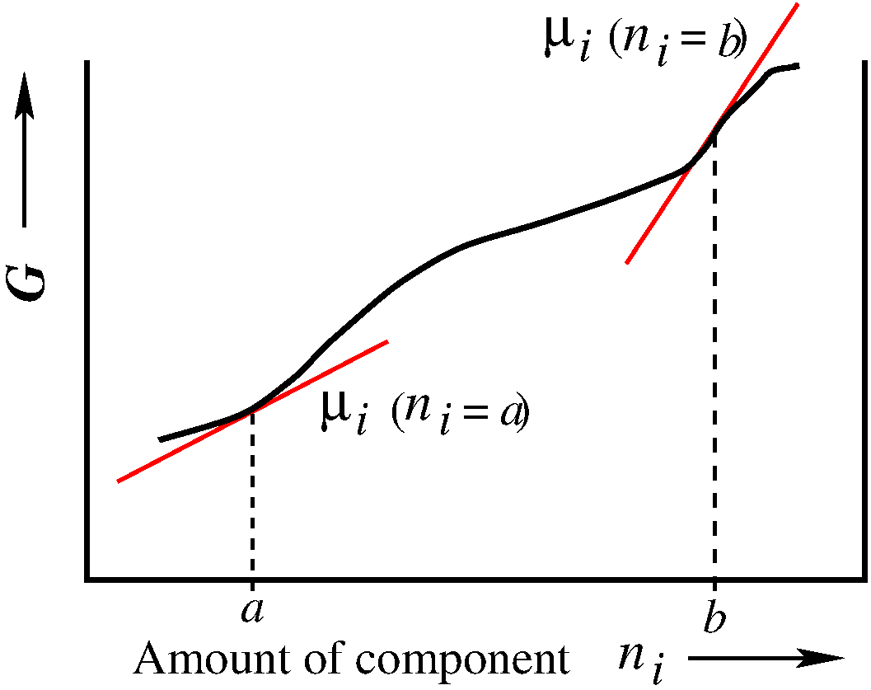
Lecture 5: Solutions and mixing processes
Solutions or mixtures with NO chemical reactions:
still
with
For perfect gas mixtures
For pure liquids
For pure solids

Slide 11
Lecture 5: Solutions and mixing processes
Solutions or mixtures with NO chemical reactions:
still
with
Standard state ϴ
for component i

Slide 12
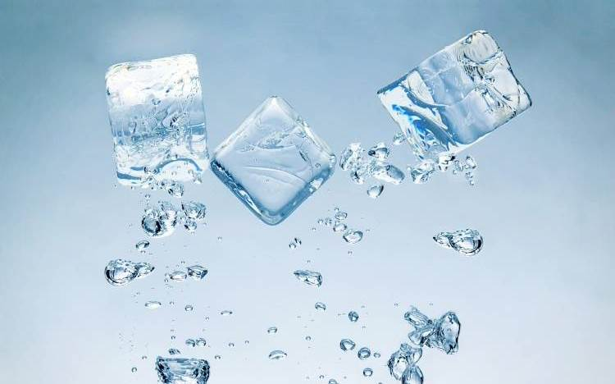
Lecture 5: Solutions and mixing processes
Importance of the chemical potential:
1) Equilibrium between phases

Slide 13
Lecture 5: Solutions and mixing processes
Importance of the chemical potential:
1) Equilibrium between phases
2nd law: in equilibrium:

Slide 14
Lecture 5: Solutions and mixing processes
Importance of the chemical potential:
1) Equilibrium between phases
2nd law: in equilibrium:
in equilibrium:

Slide 15
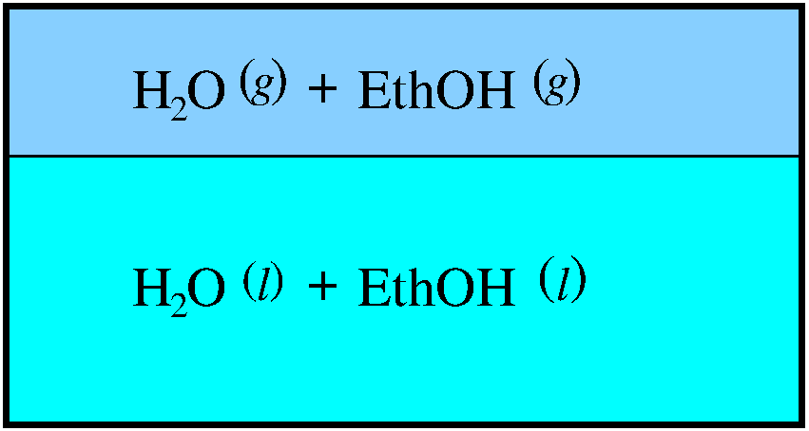
Lecture 5: Solutions and mixing processes
Importance of the chemical potential:
(Study guide p.16)
1) Equilibrium between phases
in equilibrium:
2) Equilibrium between phases of component i in mixtures
phase α
phase β
in equilibrium:

Slide 16
Lecture 5: Solutions and mixing processes
Importance of the chemical potential:
(Study guide p.16)
1) Equilibrium between phases
in equilibrium:
2) Equilibrium between phases of component i in mixtures
in equilibrium:
3) For a general mixture of two or more components A, B, ∙ ∙ ∙ :
G is a state function

Slide 17
Lecture 5: Solutions and mixing processes
Importance of the chemical potential:
(Study guide p.16)
1) Equilibrium between phases
in equilibrium:
2) Equilibrium between phases of component i in mixtures
in equilibrium:
3) For a general mixture of two or more components A, B, ∙ ∙ ∙ :

Slide 18
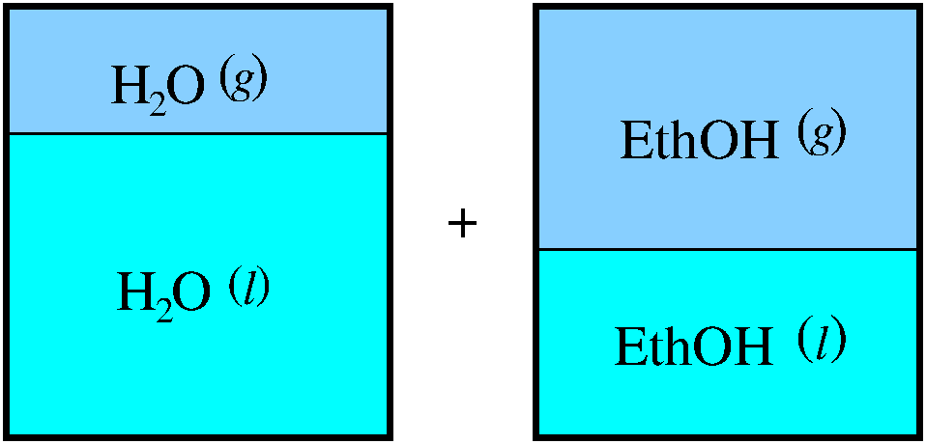
Lecture 5: Solutions and mixing processes
The process of mixing two or more components @ P,T
phase α
P,T
P,T
→
phase β
Initial:
α: pure perfect gases @ P
Initial:

Slide 19
Lecture 5: Solutions and mixing processes
The process of mixing two or more components @ P,T
phase α
P,T
P,T
→
phase β
Final:
Initial:
_

Slide 20
Lecture 5: Solutions and mixing processes
The process of mixing two or more components @ P,T
phase α
P,T
P,T
→
phase β
as
as

Slide 21
Lecture 5: Solutions and mixing processes
The process of mixing two or more components @ P,T
phase α
P,T
P,T
→
phase β
Perfect gas mixing

Slide 22
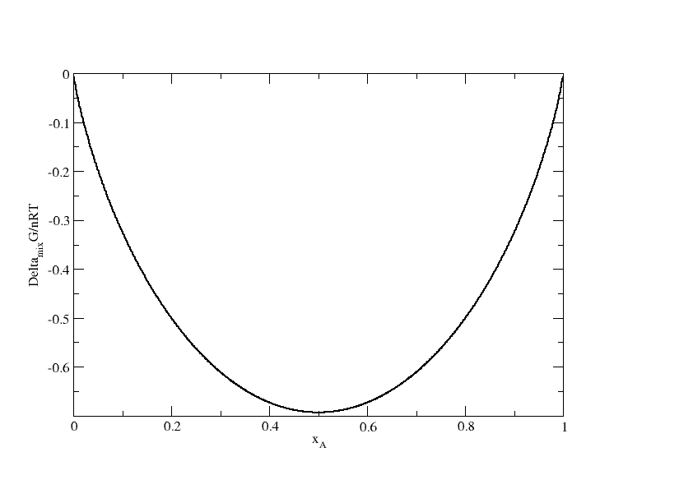
Lecture 5: Solutions and mixing processes
Perfect gas mixing

Slide 23
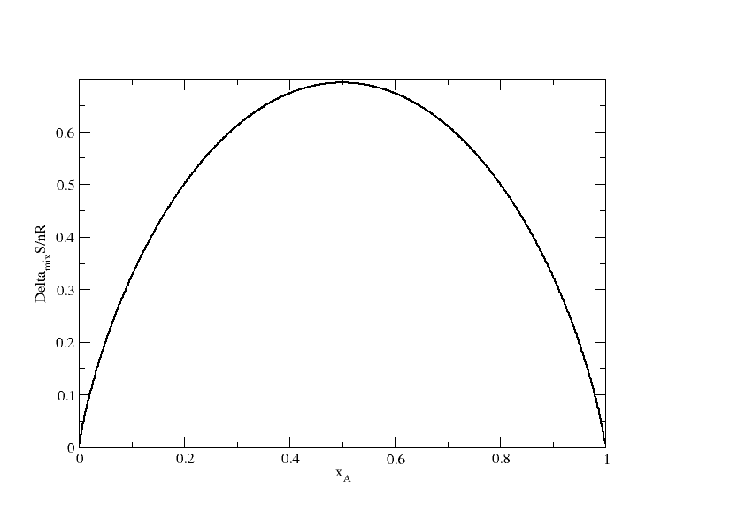
Lecture 5: Solutions and mixing processes
Perfect gas mixing
2nd law: Mixing is spontaneous, towards increasing entropy

Slide 24
Lecture 5: Solutions and mixing processes
The process of mixing two or more components @ P,T
phase α
P,T
phase β
Equilibrium
(similar for B)
perfect gas

Slide 25
Lecture 5: Solutions and mixing processes
The process of mixing two or more components @ P,T
P,T
(* pure A)
_
(similar for B)

Slide 26
Lecture 5: Solutions: Ideal solutions (Raoult)
The process of mixing two or more components @ P,T
(Study guide p.17-18)
P,T
(similar for B)
liquid
gas
Special case:
and
Ideal solution or Raoult’s law

Slide 27
Lecture 5: Solutions: Ideal solutions (Raoult)
The process of mixing two or more components @ P,T
phase α
P,T
P,T
→
phase β
Special case:
(similar for B)
liquid
liquid
Ideal solution or Raoult’s law

Slide 28
Lecture 5: Solutions: Ideal solutions (Raoult)
The process of mixing two or more components @ P,T
phase α
P,T
P,T
→
phase β
Special case:
(similar for B)
Similar to the perfect gas case:
Ideal solution or Raoult’s law

Slide 29
Lecture 5: Solutions: Ideal solutions (Raoult)
The process of mixing two or more components @ P,T
phase α
P,T
P,T
→
phase β
Special case:
(similar for B)
and
Ideal solution or Raoult’s law

Slide 30
Lecture 5: Solutions: Ideal solutions (Raoult)
The process of mixing two or more components @ P,T
and
Ideal solution or Raoult’s law
(Study guide p.17-18)

Slide 31
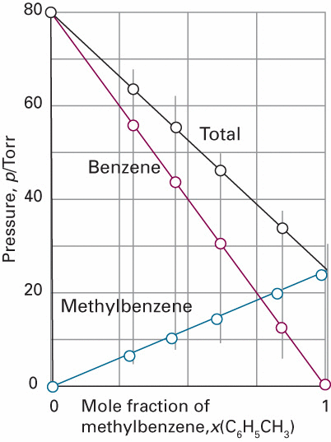
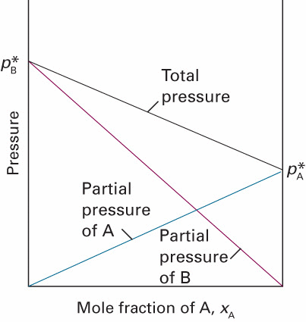
Lecture 5: Solutions: Ideal solutions (Raoult)
Raoult’s law
Raoult
Dalton

Slide 32
Lecture 5: Solutions: Real solutions
The process of mixing two or more components @ P,T
phase α
P,T
P,T
→
phase β
(similar for B)
(real solutions)

Slide 33
Lecture 5: Solutions: Colligative properties

Slide 34
Lecture 5: Solutions: Colligative properties
Colligative properties:
Effects due to the presence of a mixture in the
liquid phase in equilibrium with a
-Freezing point depression
-Boiling point elevation
-Osmosis
-Solubility
solid phase
gas phase
pure liquid
dissolved solute

Slide 35
Lecture 5: Solutions: Colligative properties
Effects due to the presence of a mixture in the
liquid phase in equilibrium with a
-Freezing point depression
-Boiling point elevation
solid phase
gas phase

Slide 36
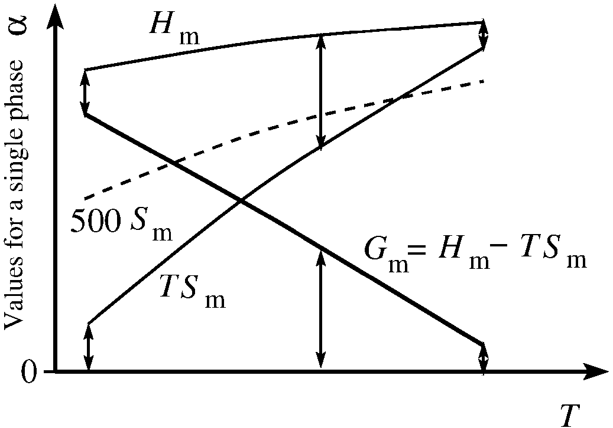
Lecture 5: Solutions: Colligative properties
Pure compound

Slide 37
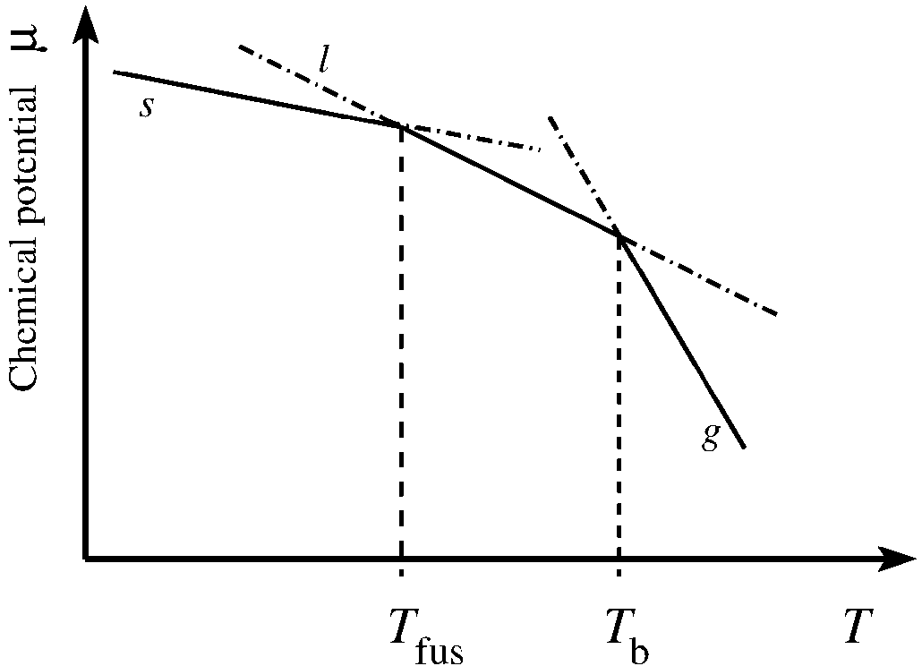
Lecture 5: Solutions: Colligative properties
Pure compound
(* pure α)
(α = s, l, g)

Slide 38
Lecture 5: Solutions: Colligative properties
(α = s, l, g)
Entropy is a measure for
amount of freedom of
the movement of molecules

Slide 39
Lecture 5: Solutions: Colligative properties
Add a solute to only the solvent
→phase g stays pure
→phase s stays pure
→phase l becomes a solution
(α = s, l, g)

Slide 40
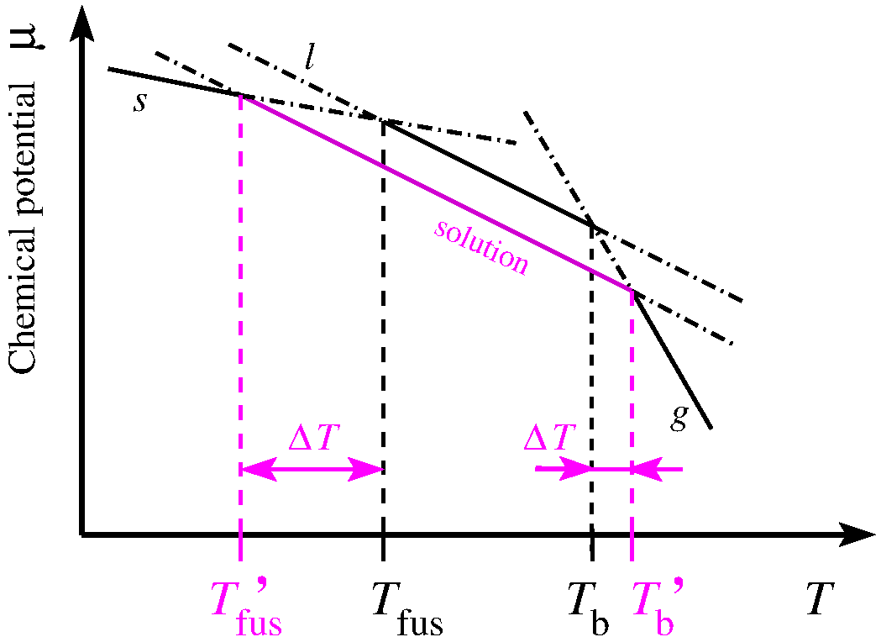
Lecture 5: Solutions: Colligative properties
(α = s, l, g)

Slide 41
Lecture 5: Solutions: Colligative properties
(α = s, l, g)
Real mixture of A and B

Slide 42
Lecture 5: Solutions: Colligative properties

Slide 43
Lecture 5: Solutions: Colligative properties
Freezing point depression
New equilibrium:

Slide 44
Lecture 5: Solutions: Colligative properties
Freesing point depression
New equilibrium:

Slide 45
Lecture 5: Solutions: Colligative properties

Slide 46
Lecture 5: Solutions: Colligative properties
For the pure compound:

Slide 47
Lecture 5: Solutions: Colligative properties
For the pure compound:

Slide 48
Lecture 5: Solutions: Colligative properties

Slide 49
Lecture 5: Solutions: Colligative properties
Assume ideal solution

Slide 50
Lecture 5: Solutions: Colligative properties

Slide 51
Lecture 5: Solutions: Colligative properties
Let’s work this out in detail

Slide 52
Lecture 5: Solutions: Colligative properties

Slide 53
Lecture 5: Solutions: Colligative properties
Freezing point depression

Slide 54
Lecture 5: Solutions: Colligative properties
Freezing point depression

Slide 55
Lecture 5: Solutions: Colligative properties
Freezing point depression
Analogously:
Boiling point elevation

Slide 56
Lecture 5: Solutions: Colligative properties
Freezing point depression
Let’s work this out in detail
Analogously:
Boiling point elevation

Slide 57
Lecture 5: Solutions: Colligative properties
Freezing point depression
Analogously:
Assumptions made:
→phase g stays pure
→phase s stays pure
→phase l becomes an ideal solution: a_{l} ≈ x_{l}
→Δ_{trs}H, Δ_{trs}S independent of T
Boiling point elevation

Slide 58
Lecture 5: Solutions: Colligative properties
Colligative properties:
Effects due to the presence of a mixture in the
liquid phase in equilibrium with a
-Freezing point depression
-Boiling point elevation
-Osmosis
-Solubility
solid phase
gas phase
pure liquid
dissolved solute

Slide 59
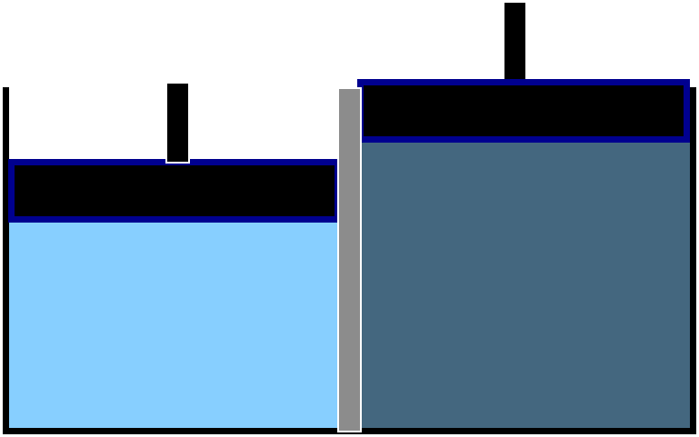

Lecture 5: Solutions: Colligative properties
Osmosis
Gain in entropy (2nd law)
A_{l}
A_{l}+B
A_{l}
A_{l}+B
P
P
P
P+Π
Semipermeable
membrane
Permeable for solvent A
Impermeable for solute B
Π is the osmotic pressure
Equilibrium:

Slide 60

Lecture 5: Solutions: Colligative properties
P
P+Π
Osmosis
Equilibrium:
A_{l}
A_{l}+B
liquid ≈ incompressible

Slide 61
Lecture 5: Solutions: Colligative properties
P
P+Π
Osmosis
Equilibrium:
A_{l}
A_{l}+B

Slide 62
Lecture 5: Solutions: Colligative properties
P
P+Π
Osmosis
Equilibrium:
A_{l}
A_{l}+B
Ideal solution
Van ’t Hoff
equation

Slide 63
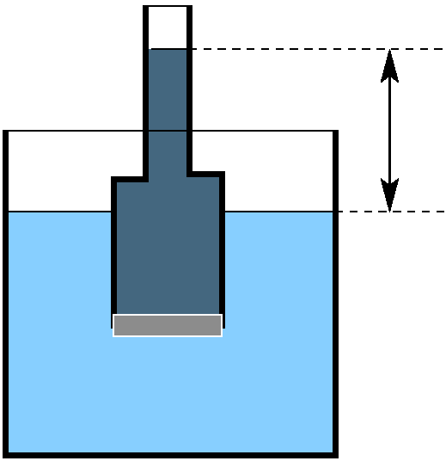
Lecture 5: Solutions: Colligative properties
P
How to measure Π ?
Equilibrium:
P
h
A_{l}+
B
Solution mass density ρ
A_{l}
Van ’t Hoff
Osmosis

Slide 64
Summary Lecture 5 (solutions)

Slide 65
Summary Lecture 5: solutions or mixtures
Equilibrium between phases of component i in mixtures
phase α
phase β
in equilibrium:
Real phase mixing
Perfect gas mixing
Ideal solution
(Raoult)

Slide 66
Summary Lecture 5: colligative properties
h
A_{l}+
B
A_{l}
P,T
Freezing point depression
Boiling point elevation
Osmosis
Ideal solution:
Ideal solution:

