Slide 1
Thermodynamics tutorhour 1

Slide 2
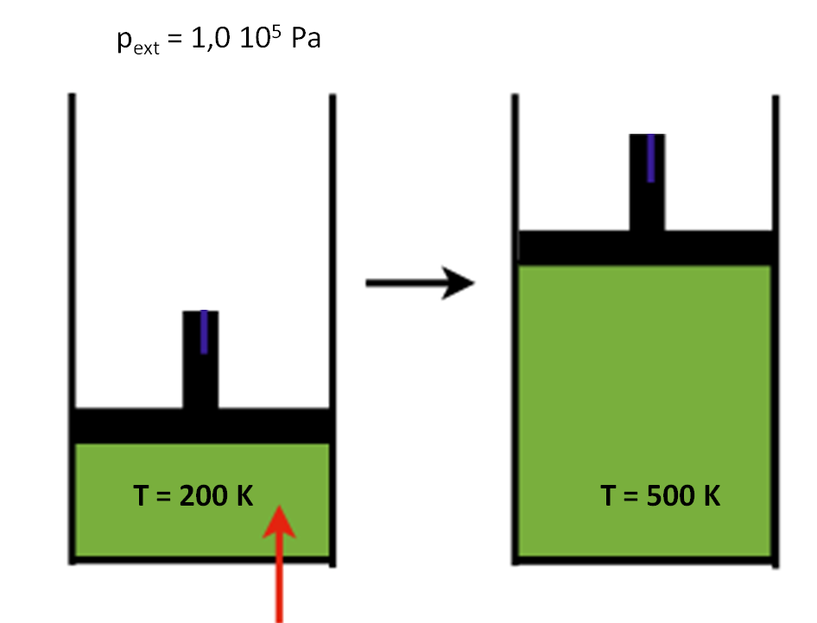
Experiment 1
1 mol of helium is heated in a cylinder with a movable piston at constant pressure (isobaric) from 200 K to 500 K.
At highschool we calculated the heat needed this way:
Q = amount of heat
m = mass
ΔT = change of temperature
c = heat capacity in J kg⁻¹ K⁻¹
in data sections J mol⁻¹ K⁻¹ is often used.
p_{ext} = 1.0·10⁵ Pa
Q_{in}

Slide 3
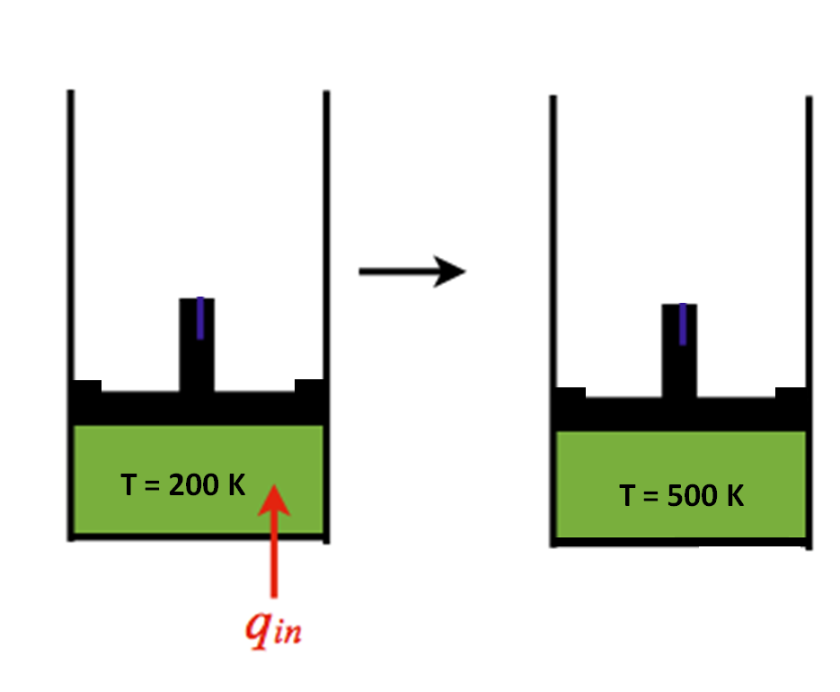
Experiment 2
The movable piston is secured now. Then the gas is heated at constant volume (isochoric) from 200 K to 500 K.
We know from experiments that only 3741 J
is needed:
Q = 3741 J
Q_{in}

Slide 4

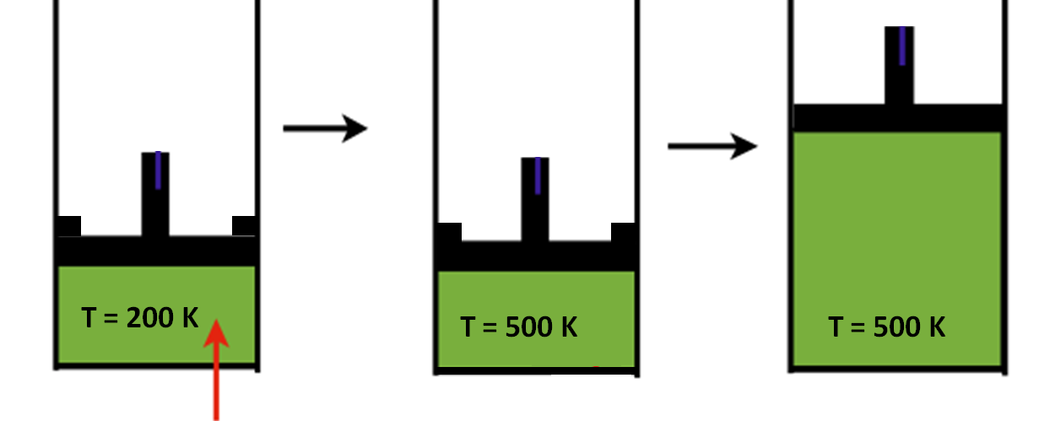
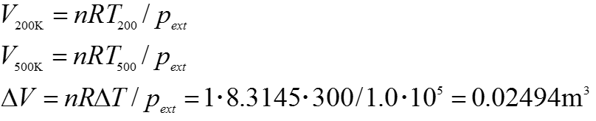
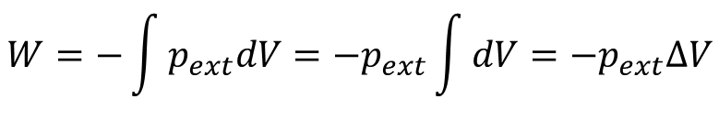

p_{ext} = 1.0·10⁵ Pa
6235 J
3741 J
?
The work is negative when the volume of the system increases!
$$W=−\int{p_{ext}dV=−p_{ext}\int{dV=−p_{ext}∆V}}$$
Q_{in}
When a gas is heated isobaric, it expands!
The air from the surroundings has to be pushed away.
Calculate the amount of work done by the gas in two different ways:
as p_{ext} is constant
$$pV=nRT$$
$$W=−\text{p}∆V=−1.0∙{10}^{5}∙0.02494=−2494 \text{J}$$

Slide 5
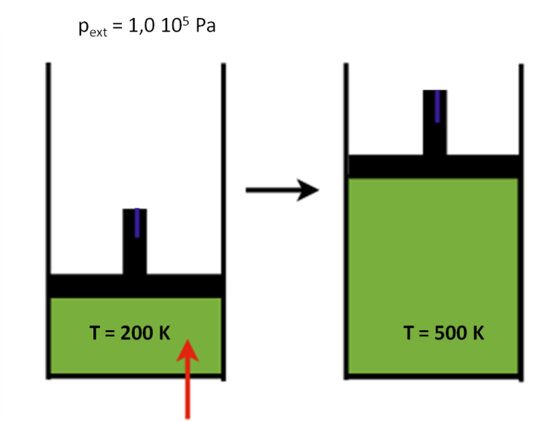
$Q=n∙c∙∆T$ becomes: $Q=n∙cp∙∆T$ or $Q=n∙cV∙∆T$
p_{ext} = 1.0·10⁵ Pa
6235 J
3741 J
Q_{in}
Q_{in}
What are the consequences for the change in internal energy (ΔU ) of the gas?
ΔU is the same for both processes!
For a mono-atomic perfect gas: U = 3/2·nRT or ΔU = 3/2·nRΔT

Slide 6



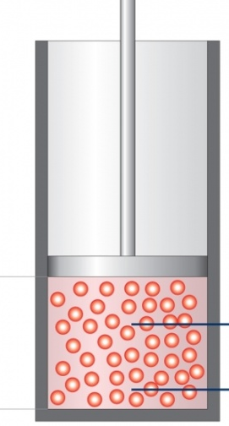
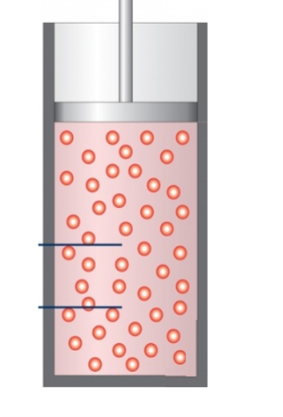
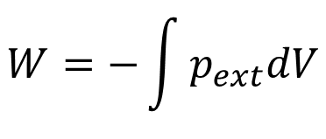
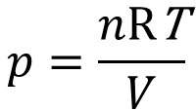
Experiment 3: Reversible expansion at constant temperature
p_{ext} = p because it is reversible
$$W=−\int{p_{ext}dV}$$
$$p=\frac{n\text{R}\text{T}}{V}$$
p_{ext} = p_{air} + p_{sand}
Now p_{ext} isn’t constant!

Slide 7
Experiment 4: Reversible expansion at constant external pressure
The bag stays closed,
T has to be raised very, very slowly.
p_{ext} = p_{air} + p_{sand} Now p_{ext} is constant!

Slide 8
Question 1
a) pV = nRT; V = nRT/p
V_{T=100} = nRT/p = 5.0·8.3145·(273 + 100)/1.0·10⁵ = 0.155 = 0.16 m³
b) Cooling down leads to a smaller volume. When the gas expands, work is done on the surroundings. In this process the surroundings exert work on the system: W > 0
c) V_{T=0} = nRT / p = 5.0·8.3145·273/1.0·10⁵ = 0.113 = 0.11 m³
d) ΔV = V_{T=0} – V_{T=100} = 0.113 – 0.155 = – 0.042 m³
because p is constant:
W = – pΔV
W = – 1.0·10⁵· (– 0.042) = 4.2·10³ J
e) ΔU = 3/2·nRΔT = – 6236 J = – 6.2 kJ

Slide 9
Question 2
– 1.0·10⁵·1.0·10⁻³ = – 1.0·10² J
Question 3
ΔU = 3/2nRΔT; isothermic, so ΔT = 0 K and therefore ΔU = 0 J
W = – p_{ext}ΔV; p_{ext} = 0 Pa so W = 0 J
Q = ΔU – W = 0 – 0 = 0 J
ΔU = 0 J; dW = –∫p_{ext}dV; p_{ext}= nRT/V; W = – nRT ∫(1/V)dV = – nRT ln(V₂/V₁) = – 1573 J
Q = ΔU – W = 1573 J
c) ΔU = 0 J; dW = – p_{ext}dV; p_{ext} is constant, so W = – p_{ext}·ΔV = – (nRT/V_{f})·ΔV
W = – (1.0·8.3145·273/44.8·10⁻³)·(22.4·10⁻³) = – 1135 J
Q = ΔU – W = 1135 J
Question 4
p₁/T₁ = p₂/T₂; p₂ = p₁·T₂/T₁ = 1.33·10⁵ Pa
ΔU = 3/2·nRΔT = 1247 J
W = – ∫pdV in which dV = 0 so W = 0 J
Q = ΔU – W = 1247 – 0 = 1247 J

