Slide 1
Thermodynamics tutorhour 4
Electrochemistry

Slide 2
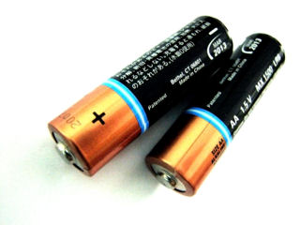
Electrochemical cells
Nernst Equation

Slide 3
∆_{r}G = -νF∆E_{cell}
Electrochemical cell p,T constant:
ν: number of transferred electrons (according to the chemical equation)
F: Faraday constant = 96 485 C/mol
∆E_{cell} : electromotive force of the cell
If a process is spontaneous then: ∆_{r}G ≤ 0 (p,T constant)
So for a battery:
∆E_{cell} ≥ 0 (p,T constant)

Slide 4
Standard conditions
∆_{r}G^{Ɵ} = -νF∆E_{cell}^{Ɵ}
oxidizing agent |  | reducing agent | E^{Ɵ} (V)
Cu²⁺ + 2 e⁻ | → | Cu | + 0.34
2 H⁺ + 2 e⁻ | → | H₂ | 0.000000
Zn²⁺ + 2 e⁻ | → | Zn | - 0.76
Redox table
T = 298 K, p = p^{Ɵ} and
all activities a = 1
Standard Daniell cell: Zn(s) | Zn²⁺ || Cu²⁺ | Cu(s)
∆E_{cell}^{Ɵ} = 0.34 – (– 0.76) = 1.10 V
∆_{r}G^{Ɵ} = – 2 · 96485 · 1.10 = – 2.12·10⁵ J mol⁻¹ < 0

Slide 5
If p ≠ p^{Ɵ} and/or a ≠ 1, apply a correction:
Non-standard conditions
For each electrode: Ox + ν e⁻ → Red
E: potential of the electrode
Q refers to the half-reaction of the cell
For overall potential:
Q: reaction quotient
(similar to concentration quotient)

Slide 6
Example: the nickel chromium battery
Ni²⁺ + 2e⁻ → Ni
Cr → Cr³⁺ + 3e⁻
3 Ni²⁺ + 2 Cr → 3 Ni + 2 Cr³⁺
3x
2x
ν = 6 and
If the activities are known you can calculate the potential by:
see last slide for explanation

Slide 7
How to construct a chemical half reaction yourself
put the formula of the particle that reacts on the left hand side, and the formula of the particle that appears on the right hand side of the equation
put coëfficiënts in front of these formulas, to make sure all elements - except H and O - are equally present before and after the arrow
equal the missing O-atoms with H₂O
equal the missing H-atoms with H⁺
equal the charge with e⁻
check the environment:
- if it is neutral, there can’t be any H⁺ ions present on the left hand side of the equation
- if it is basic, there can’t be any H⁺ ions present on any side of the equation
In both cases, add as much OH⁻ ions as you need to neutralize the H⁺ ions to form H₂O.
Don’t forget to add the same amount of OH⁻ ions on the other side of the equation!

Slide 8
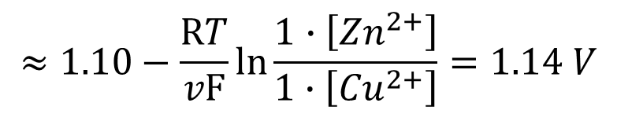
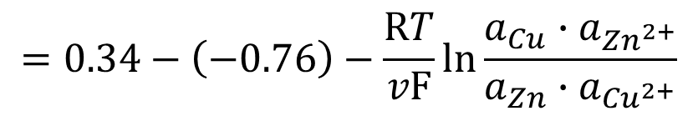
Answers
Question 1
Cu²⁺ + Zn(s) → Cu(s) + Zn²⁺
Question 2
H₂(g) → 2 H⁺ + 2e⁻ E^{Θ} = 0.00 V
2 Ag²⁺ + 2e⁻ → 2 Ag⁺ E^{Θ} = 1.98 V
2 Ag⁺ + 2e⁻ → 2 Ag E^{Θ} = 0.80 V
2 Ag + CrO₄²⁻ → Ag₂CrO₄ + 2e⁻ E^{Θ} = - 0.45 V (reversed!)
H₂(g) + CrO₄²⁻ + 2 Ag²⁺ → Ag₂CrO₄ + 2 H⁺ ΔE_{cell}^{Θ} = 2.33 V
$$=0.34−\left(−0.76\right)−\frac{RT}{v\text{F}}ln\frac{a_{Cu}∙a_{{Zn}^{2+}}}{a_{Zn}∙a_{{Cu}^{2+}}}$$
$$≈1.10−\frac{RT}{v\text{F}}ln\frac{1∙\left[{Zn}^{2+}\right]}{1∙\left[{Cu}^{2+}\right]}=1.14 V$$

Slide 9
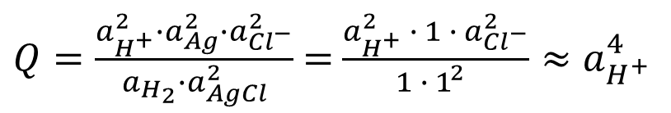
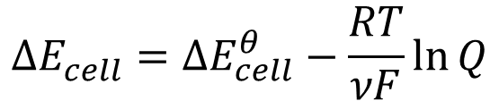
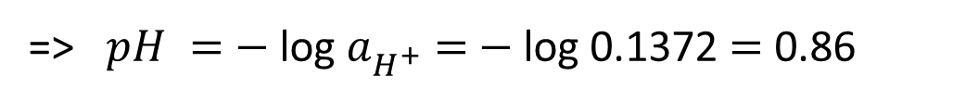
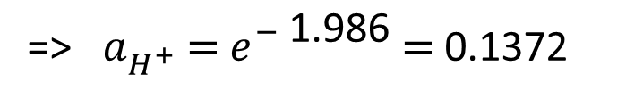
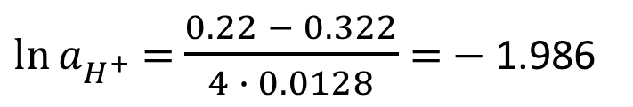
Question 3
2 AgCl + 2e⁻ → 2 Ag + 2 Cl⁻ E^{Θ} = 0.22 V
H₂(g) → 2 H⁺ + 2e⁻ E^{Θ} = 0.00 V +
H₂(g) + 2 AgCl → 2 H⁺ + 2 Ag + 2 Cl⁻ ΔE_{cell}^{Θ} = 0.22 V
$$∆E_{cell}^{}={∆E}_{cell}^{θ}−\frac{RT}{νF}\ln{Q}$$
$Q=\frac{a_{H^{+}}^{2}∙a_{Ag}^{2}{∙a}_{{Cl}^{−}}^{2}}{a_{H_{2}}∙a_{AgCl}^{2}}$ $=$ $\frac{a_{H^{+}}^{2} ∙ 1 {∙ a}_{{Cl}^{−}}^{2}}{1 ∙ 1_{}^{2}}≈a_{H^{+}}^{4}$
$$0.322=0.22−\frac{8.3145∙298}{2∙9.6485∙10^{4}}\ln{a_{H^{+}}^{4}}=0.22−0.0128∙\ln{a_{H^{+}}^{4}=0.22−4∙0.0128∙\ln{a_{H^{+}}^{}}}$$
$\ln{a_{H^{+}}^{}}$ $=$ $\frac{0.22 − 0.322}{4 ∙ 0.0128}$ $=$ $−$ 1.986
=> $a_{H^{+}}^{}$ $=$ $e_{}^{−\text{ 1.986}}$ $=$ 0.1372
=> $pH =$ $−$ log $a_{H^{+}}^{}$ $=$ $−$ log 0.1372 $=$ 0.86

Slide 10
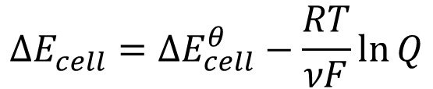
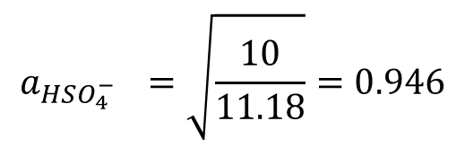
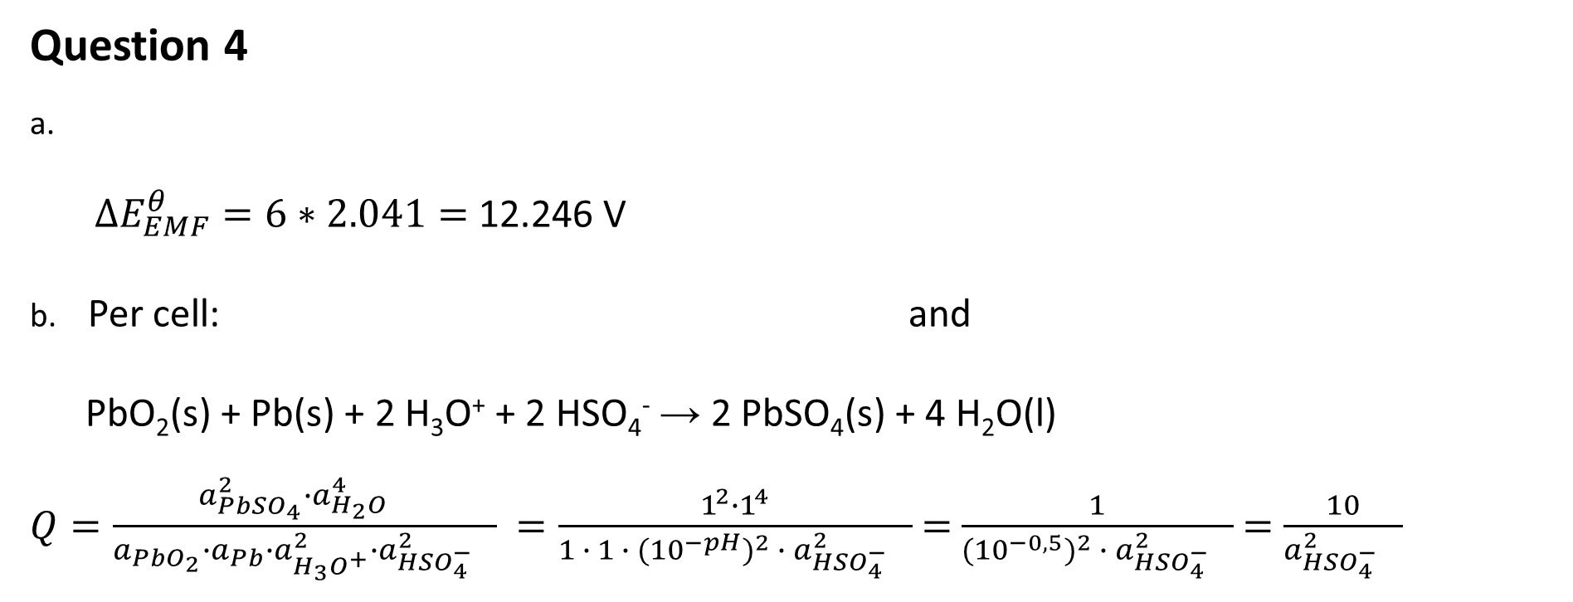
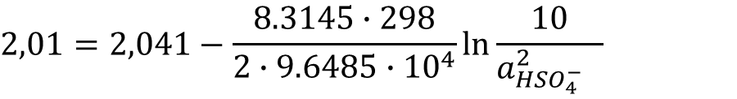
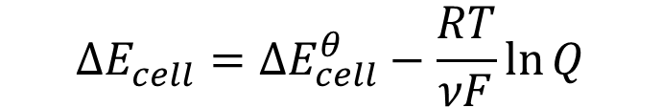
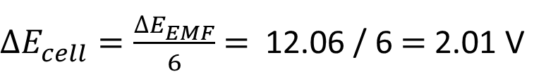
Question 4
a.
$∆E_{EMF}^{θ}=6∗2.041=$ 12.246 V
b. Per cell: and
PbO₂(s) + Pb(s) + 2 H₃O⁺ + 2 HSO₄⁻ → 2 PbSO₄(s) + 4 H₂O(l)
$Q=\frac{a_{PbSO_{4}}^{2}∙a_{{H_{2}O}_{}}^{4}}{a_{PbO_{2}}∙a_{Pb}∙a_{H_{3}O^{+}}^{2}∙a_{{HSO_{4}^{−}}_{}}^{2}}$ $=\frac{1^{2}∙1^{4}}{1 ∙ 1 ∙ (10^{−pH})^{2} ∙ a_{{HSO_{4}^{−}}_{}}^{2}}$ $=$ $\frac{1}{(10^{−0,5})^{2} ∙ a_{{HSO_{4}^{−}}_{}}^{2}}$ $=$ $\frac{10}{a_{{HSO_{4}^{−}}_{}}^{2}}$
$$∆E_{cell}^{θ}=E_{+pole}^{θ}−E_{−pole}^{θ}=\text{ 1.685 }−\text{ (}−\text{ 0.356) }=\text{ 2.041 }\text{V}$$
$∆E_{cell}^{}=\frac{{∆E}_{EMF}^{}}{6}$ $=$ 12.06 / 6 $=$ 2.01 V
$$∆E_{cell}^{}={∆E}_{cell}^{θ}−\frac{RT}{νF}\ln{Q}$$
$$∆E_{cell}^{}={∆E}_{cell}^{θ}−\frac{RT}{νF}\ln{Q}$$
$$2,01=2,041−\frac{8.3145∙298}{2∙9.6485∙10^{4}}\ln{\frac{10}{a_{{HSO_{4}^{−}}_{}}^{2}} }$$
<=>
$$a_{{HSO_{4}^{−}}_{}}^{}=\sqrt{\frac{10}{11.18}}=0.946$$
=>

Slide 11
Explanation for nickel chromium battery
fill in for the reduction reaction:
the terms together and because { y·ln(x) = y/2·ln(x²) }
Fill in: ΔE_{cel} = E_{+ pole} – E_{- pole}
y·ln (b) – y·ln (c) = y·ln (b/c)
By changing the quotients the – ln becomes + ln
Ni²⁺ + 2e⁻ ⇄ Ni
Cr³⁺ + 3e⁻ ⇄ Cr
Ni²⁺ + 2e⁻ → Ni
Cr → Cr³⁺ + 3e⁻
3 Ni²⁺ + 2 Cr → 3 Ni + 2 Cr³⁺
3x
2x

