Slide 1
Thermodynamics tutorhour 5
Colligative properties

Slide 2
Elevation of boiling point
At equilibrium:
µ_{gas} = µ_{liq}
p = p₀
C₆H₁₄(g)
At (69⁰C):
µ*_{gas} = µ*_{liq}
C₆H₁₄(l)

Slide 3
Elevation of boiling point
At equilibrium:
µ_{gas} = µ_{liq}
p = p₀
C₆H₁₄(g)
µ*_{gas} = µ*_{liq} + correction for dissolving
C₆H₁₄(l)
+
C₂₀H₄₂(l)
p = p₀ , ideal dilute solution (low concentration)

Slide 4
Elevation of boiling point
p = p₀
C₆H₁₄(g)
∆T : elevation of boiling point
: boiling point of pure hexane
∆_{vap}H : enthalpy of vaporization of hexane
x_{B} : mole fraction of eicosane
C₆H₁₄(l)
+
C₂₀H₄₂(l)
p = p₀ , ideal dilute solution

Slide 5
The depression of freezing point
∆T : depression of freezing point
: freezing point of the pure solvent
∆_{fus}H : enthalpy of fusion of the solvent
x_{B} : mole fraction of the dissolved solute
p = p₀ , ideal dilute solution

Slide 6
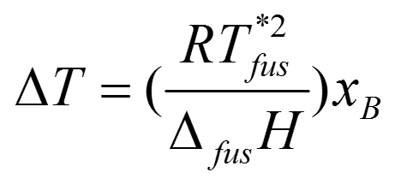
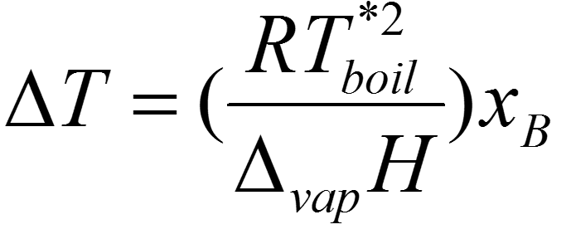
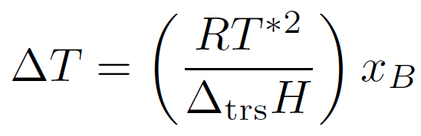
Boiling point elevation and freezing point depression
See also the
checklist of
key equations
trs = transition
p = p₀ , ideal dilute solution

Slide 7
Osmotic pressure
p = p₀
At equilibrium:
µ_{hexane,left} = µ_{hexane,right}
hexane
hexane
µ*_{hexane} = µ*_{hexane}

Slide 8
Osmotic pressure
additional pressure:
p = p₀
h
p = p₀+ Π
At equilibrium:
µ_{hexane,left} = µ_{hexane,right}
hexane
hexane
and
eicosane
µ*(p₀)_{hexane} = µ(p₀+Π)_{mixture}
µ*(p₀)_{hexane} = µ*(p₀)_{hexane} + correction for dissolving + additional pressure

Slide 9
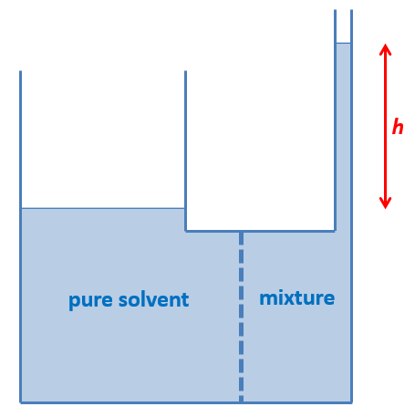
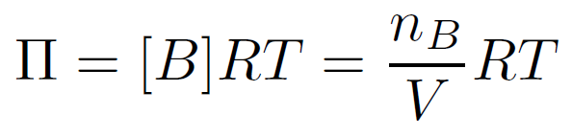
Osmotic pressure
µ*(p₀)_{hexane} = µ*(p₀)_{hexane} + correction for dissolving + additional pressure
p = p₀ , ideal dilute solution
Note: [B] in mol/m³
Osmotic pressure can also be expressed as a function of height h:
pressure: p = F_{z} / A
weight: F_{z} = m·g
mass: m = ρ·V
pressure: p = F_{z} / A = m·g /A = ρ·V·g /A = ρ·g· V/A → Π = ρ·g·h

Slide 10
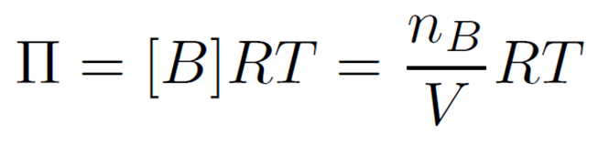
Osmotic pressure
Π = ρ·g·h
p = p₀
h
At very low concentration:
ρ = ρ_{solution}≈ ρ_{solvent}
so in approximation:
Π = ρ_{solvent}·g·h
hexane
hexane
and
eicosane
and earlier we saw:

Slide 11
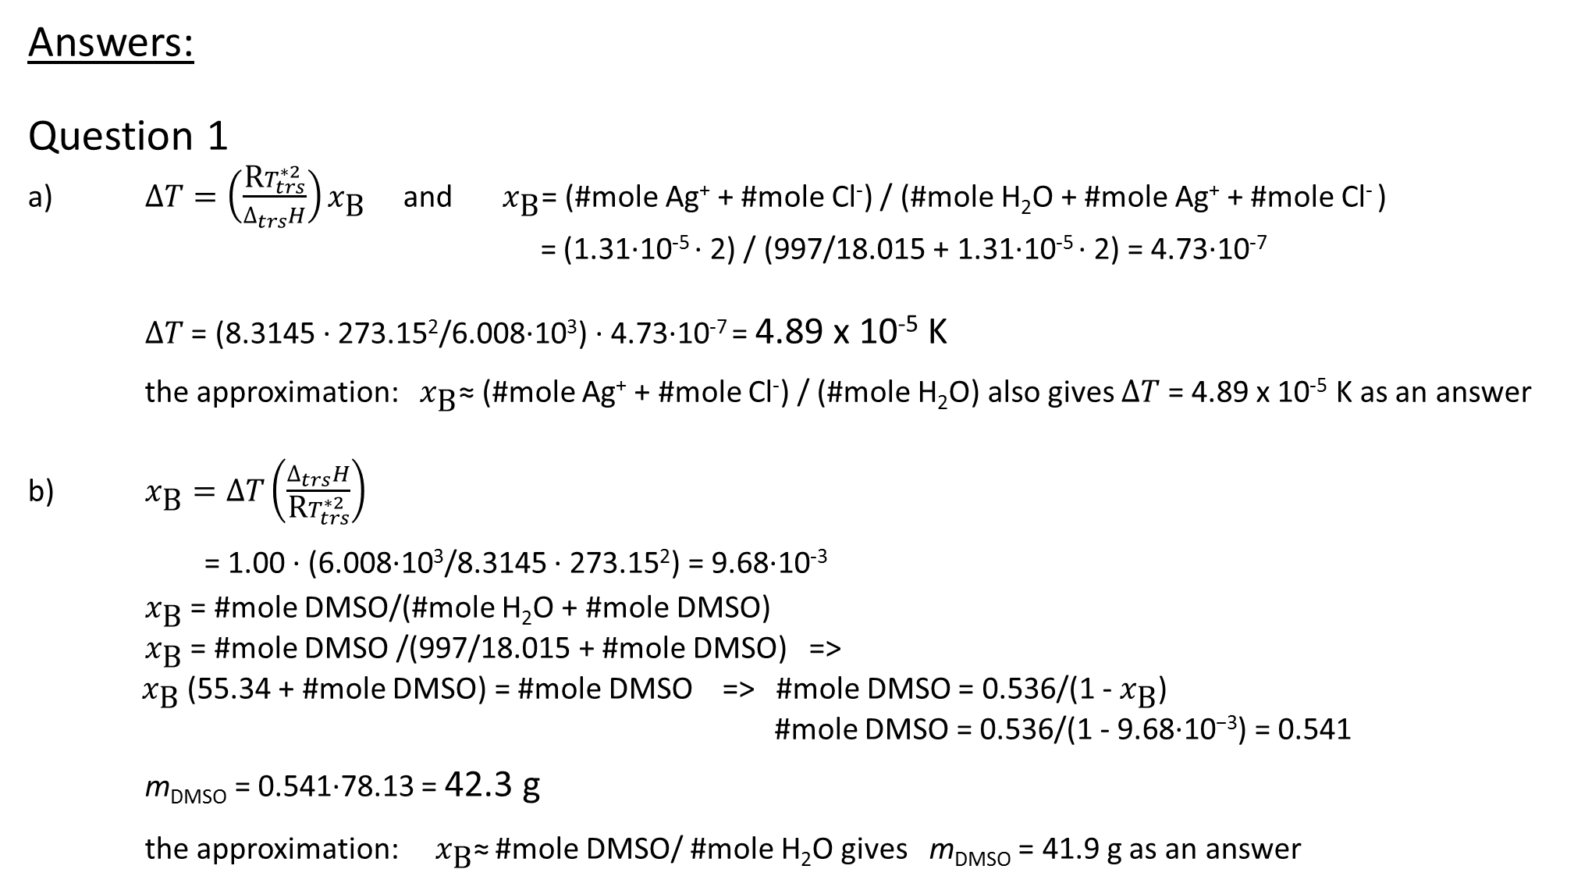
Answers:
Question 1
a) $∆T=\left(\frac{\text{R}T_{trs}^{∗2}}{∆_{trs}H}\right)x_{\text{B}}$ and $x_{\text{B}}$= (#mole Ag⁺ + #mole Cl⁻) / (#mole H₂O + #mole Ag⁺ + #mole Cl⁻ )
= (1.31·10⁻⁵ · 2) / (997/18.015 + 1.31·10⁻⁵ · 2) = 4.73·10⁻⁷
$∆T$ = (8.3145 · 273.15²/6.008·10³) · 4.73·10⁻⁷ = 4.89 x 10⁻⁵ K
the approximation: $x_{\text{B}}$≈ (#mole Ag⁺ + #mole Cl⁻) / (#mole H₂O) also gives $∆T$ = 4.89 x 10⁻⁵ K as an answer
b) $x_{\text{B}}=∆T\left(\frac{∆_{trs}H}{\text{R}T_{trs}^{∗2}}\right)$
= 1.00 · (6.008·10³/8.3145 · 273.15²) = 9.68·10⁻³
$x_{\text{B}}$ = #mole DMSO/(#mole H₂O + #mole DMSO)
$x_{\text{B}}$ = #mole DMSO /(997/18.015 + #mole DMSO) =>
${ x}_{\text{B}}$ (55.34 + #mole DMSO) = #mole DMSO => #mole DMSO = 0.536/(1 - $x_{\text{B}}$)
#mole DMSO = 0.536/(1 - $\text{9.68·10}\text{−3}$) = 0.541
m_{DMSO} = 0.541·78.13 = 42.3 g
the approximation:$x_{\text{B}}$≈ #mole DMSO/ #mole H₂O gives m_{DMSO} = 41.9 g as an answer

Slide 12
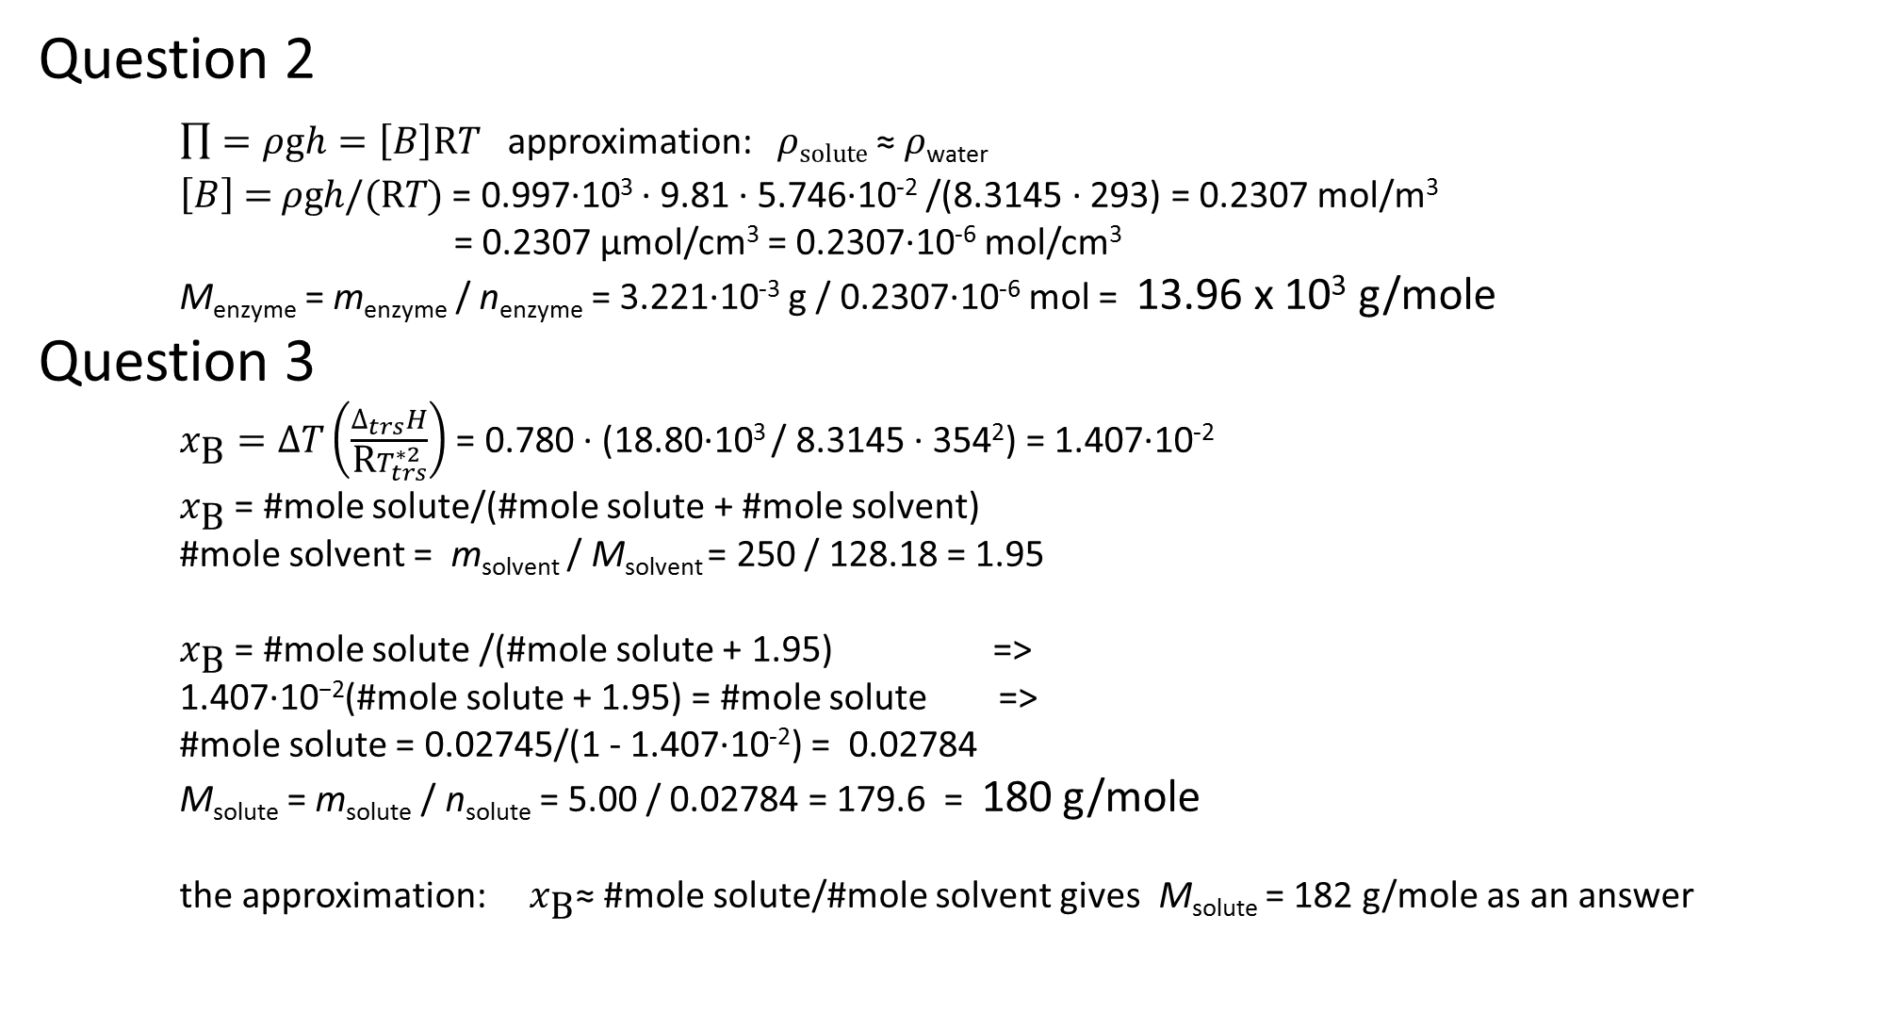
Question 2
$\prod{=ρ\text{g}h=\left[B\right]\text{R}T}$ approximation: $ρsolute$≈ $ρ$_{water}
$\left[B\right]\text{ =} ρ\text{g}h\text{/(}\text{R}T)$ = 0.997·10³ · 9.81 · 5.746·10⁻² /(8.3145 · 293) = 0.2307 mol/m³
= 0.2307 μmol/cm³ = 0.2307·10⁻⁶ mol/cm³
M_{enzyme} = m_{enzyme} / n_{enzyme} = 3.221·10⁻³ g / 0.2307·10⁻⁶ mol = 13.96 x 10³ g/mole
Question 3
    $x_{\text{B}}=∆T\left(\frac{∆_{trs}H}{\text{R}T_{trs}^{∗2}}\right)$ = 0.780 · (18.80·10³ / 8.3145 · 354²) = 1.407·10⁻²
$x_{\text{B}}$ = #mole solute/(#mole solute + #mole solvent)
#mole solvent = m_{solvent} / M_{solvent} = 250 / 128.18 = 1.95
$x_{\text{B}}$ = #mole solute /(#mole solute + 1.95) =>
$\text{1.407·10}\text{−2}$(#mole solute + 1.95) = #mole solute =>
#mole solute = 0.02745/(1 - 1.407·10⁻²) = 0.02784
M_{solute} = m_{solute} / n_{solute} = 5.00 / 0.02784 = 179.6 = 180 g/mole
the approximation: $x_{\text{B}}$≈ #mole solute/#mole solvent gives M_{solute} = 182 g/mole as an answer

