Slide 1
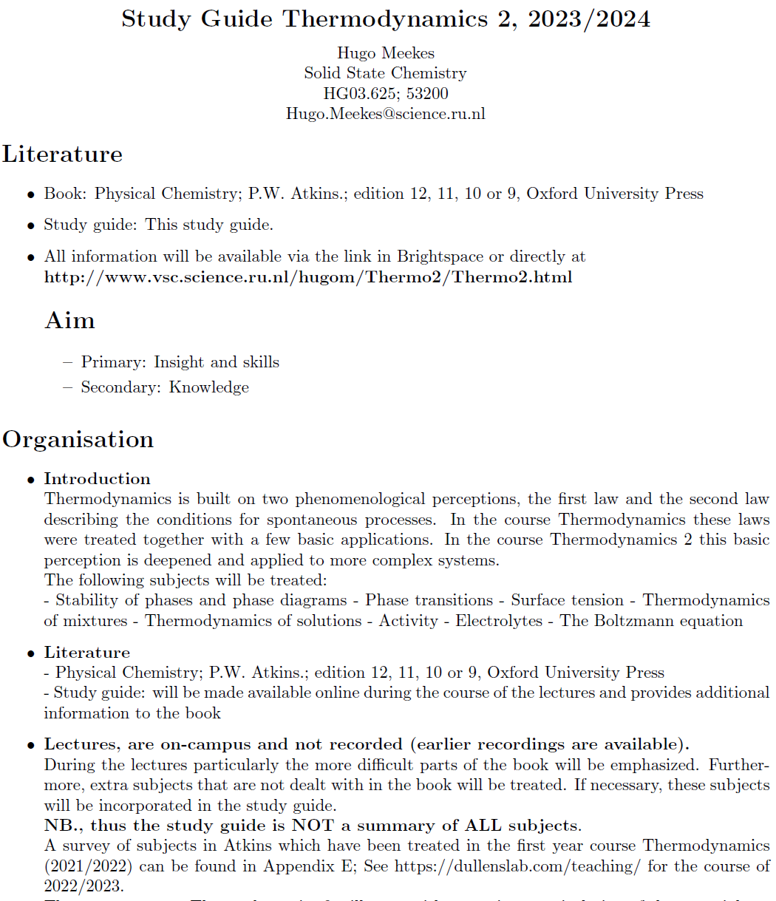

Slide 2
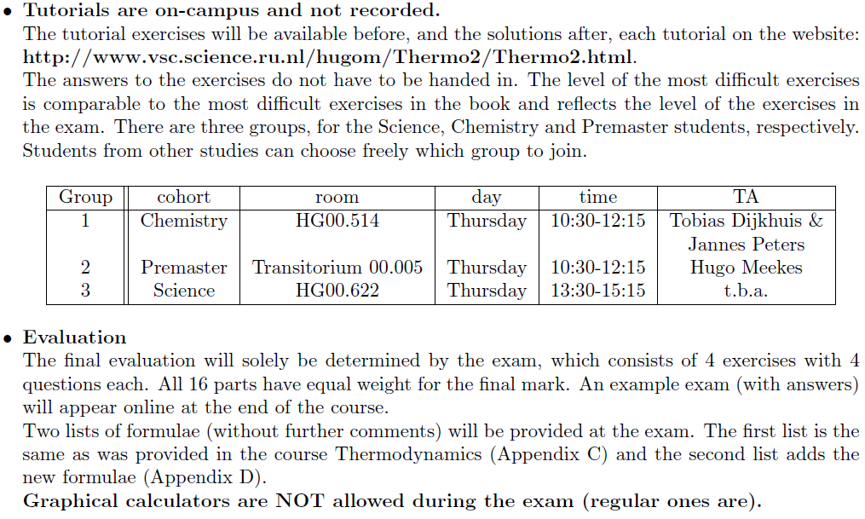

Slide 3
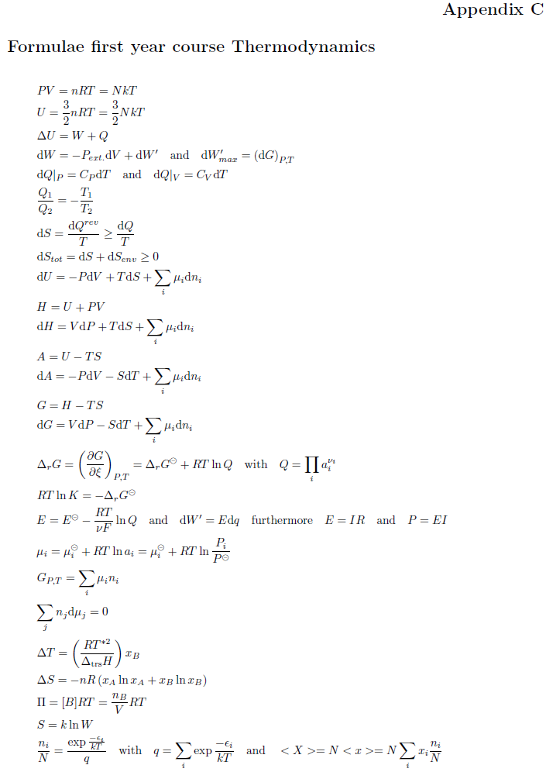
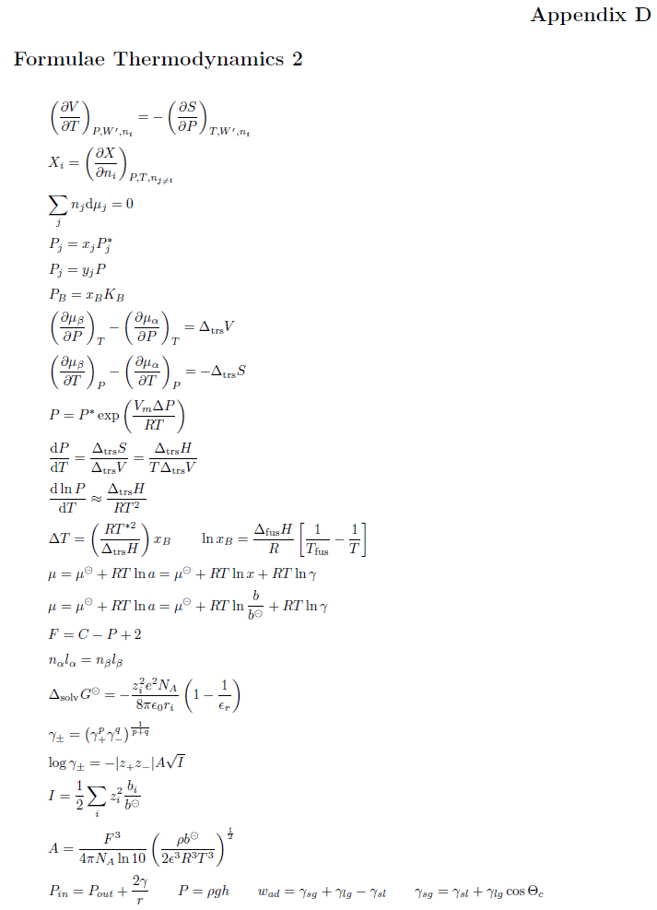

Slide 4
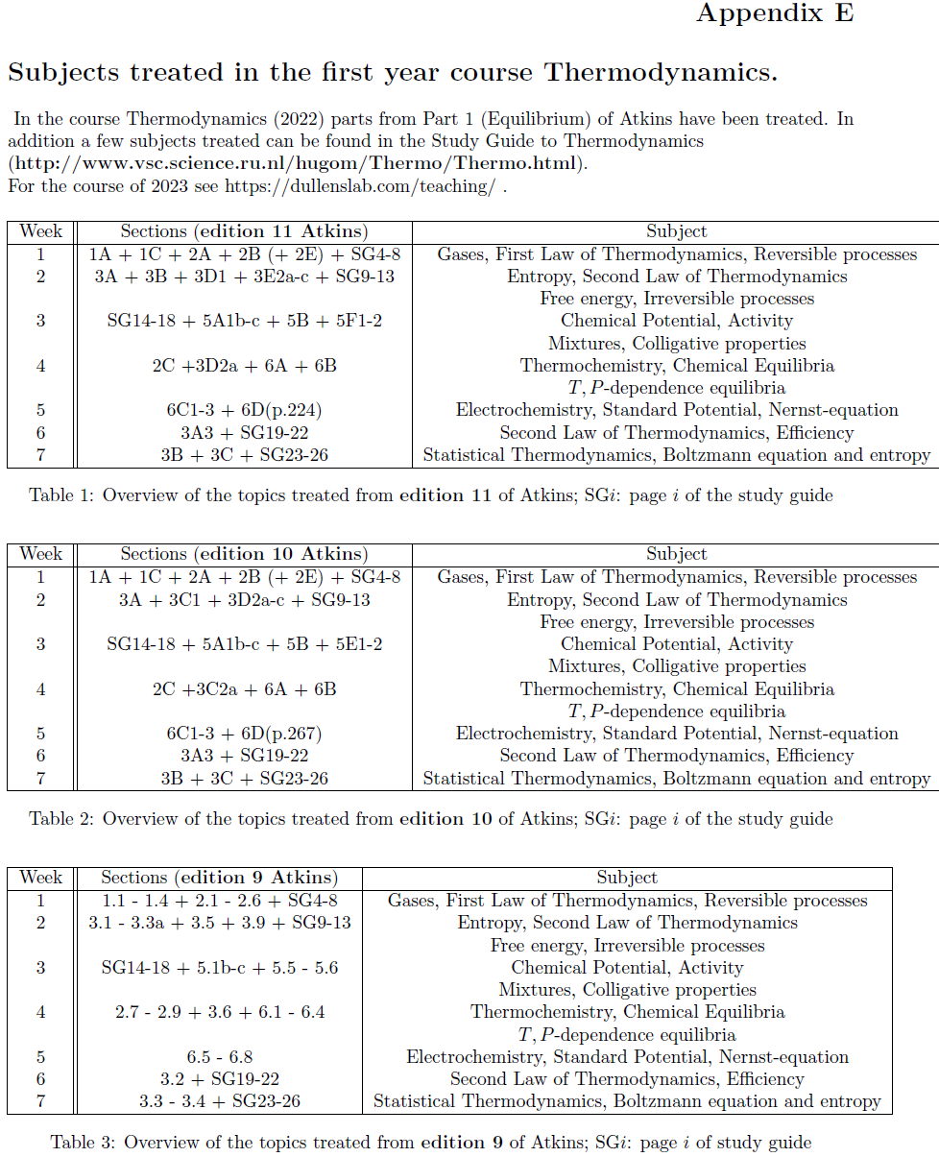

Slide 5
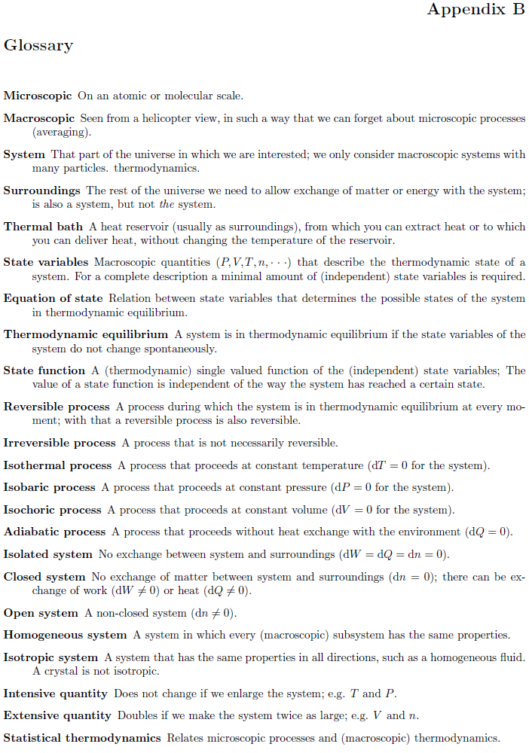

Slide 7
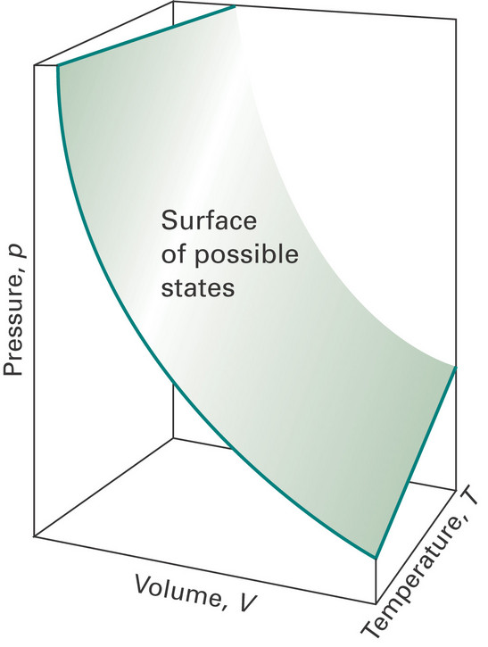
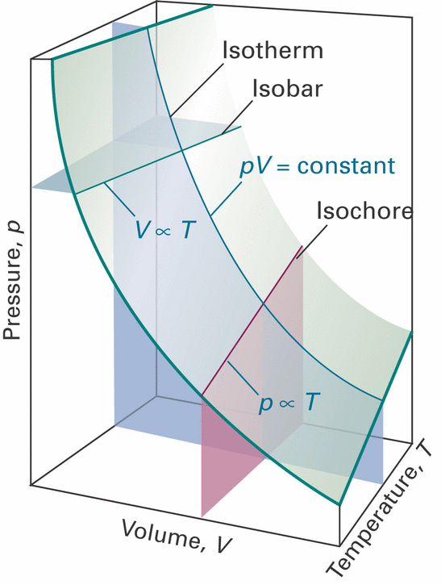
Perfect gas: PV = nRT = NkT (equation of state)
Closed system: n constant (dn = 0)
(=> 4 variables reduced to 3)

Slide 8
Perfect gas: PV = nRT = NkT (equation of state)
Only in thermodynamic equilibrium!
Closed system: n constant (dn = 0)
(=> 4 variables reduced to 3)

Slide 9
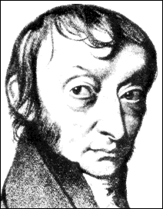
J/mol K
J/K
Amadeo Avogadro di Quaregna e Cerreto

Slide 10
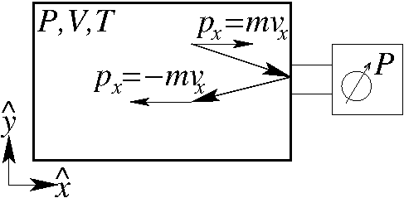
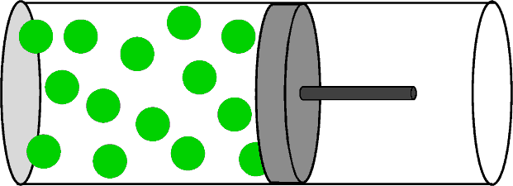
Perfect gas: from atoms to molecules
(Study guide p.3-4)
Atomic perfect gas
Internal energy
of the system

Slide 11
Perfect gas: from atoms to molecules
(Study guide p.3-4)
Atomic perfect gas
Only for atomic
perfect gas!
Internal energy
of the system

Slide 12
Perfect gas: from atoms to molecules
(Study guide p.17-18)
Internal energy
Atomic perfect gas
Internal energy of a system with 3N degrees of freedom
(equipartition theorem)

Slide 13
Perfect gas: from atoms to molecules
(Study guide p.17-18)
Internal energy
per degree of freedom
(equipartition theorem)
Atomic perfect gas
(x,y,z)
(N atoms)
3N degrees of freedom

Slide 14
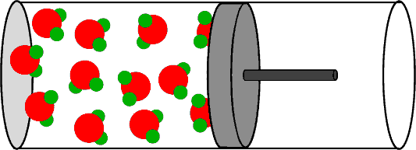
Perfect gas: from atoms to molecules
Only Translational
degrees of freedom
Also Rotational and Vibrational
degrees of freedom
Atomic perfect gas
Molecular perfect gas

Slide 15
Perfect gas: from atoms to molecules
Rotational
degrees of freedom
atom
linear
non-linear
Molecular perfect gas
(M molecules)
(N_{R} = # Rotation axes)

Slide 16
Perfect gas: from atoms to molecules
Rotational
degrees of freedom
Vibrational
degrees of freedom
atom
In total: N atoms in
M molecules
linear
non-linear
3N degrees of freedom

Slide 17
Perfect gas: from atoms to molecules
Rotational
degrees of freedom
Vibrational
degrees of freedom
atom
linear
non-linear
N_{m}: # atoms/molecule

Slide 18
Perfect gas: from atoms to molecules
Rotational
degrees of freedom
Vibrational
degrees of freedom
atom
linear
non-linear
Vibrational energy
Chemical bond: kinetic and potential energy

Slide 19
Perfect gas: from atoms to molecules
(Study guide p.17-18)
Perfect gas
obeys the
equipartition theorem
(high T and low P)
Atomic perfect gas
Molecular perfect gas
Exercise 1

Slide 20
Perfect gas: from atoms to molecules
(Study guide p.17-18)
Perfect gas
obeys the
equipartition theorem
(high T and low P)
Let’s work this out in detail
Atomic perfect gas
Molecular perfect gas
Exercise 1

Slide 22
Perfect gas: PV = nRT = NkT (equation of state)
Only for the system in equilibrium
Closed system: n constant (dn = 0)

Slide 23
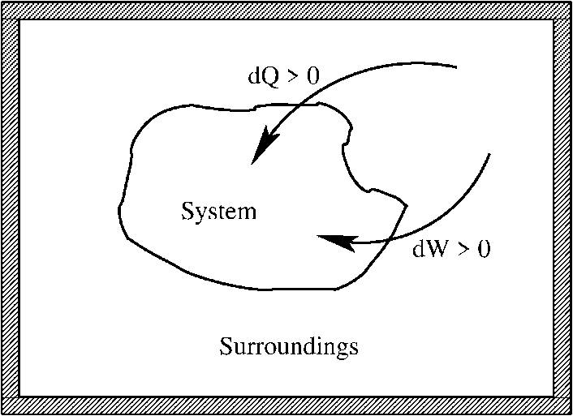
General case: equilibrium thermodynamics
process
(Study guide p.5-10)
Irreversible processes: non-equilibrium and spontaneous

Slide 24
General case: equilibrium thermodynamics
process
(Study guide p.5-10)
Irreversible processes: non-equilibrium and spontaneous
Reversible processes: always equilibrium and not spontaneous
entropy

Slide 25
General case: equilibrium thermodynamics
First law:
irreversible
reversible
First law: dU for an
irreversible process can be
determined by an alternative
reversible process
entropy

Slide 26
General case: equilibrium thermodynamics
U is a
state function
irreversible
reversible
First law: dU for an
irreversible process can be
determined by an alternative
reversible process
entropy

Slide 27
General case: equation of state
Only for the system in equilibrium
only three independent variables
are the state variables
of the system
For a closed system: n constant (dn = 0)
only two independent variables

Slide 28
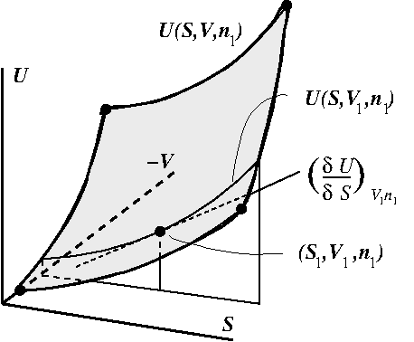
Total differential of a state function: U
characteristic equation
(closed system)
First law:

Slide 29
Total differential of a state function: U
(closed system)

Slide 30
Total differential of a state function: U
characteristic equation
(closed system)

Slide 31
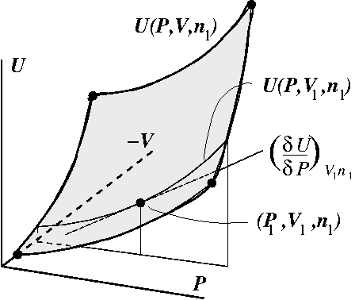
Total differential of a state function: U
(SG: appendix A)
(closed system)
Choose
P and V
as
independent
variables
T follows from the equationof state

Slide 32
Total differential of a state function: U
(characteristic equation)
(closed system)
T follows from the equationof state
dP is not the most convenient variable for dU

Slide 33
Introduce new energy function: Enthalpy H
(SG: page 6)
Enthalpy H
Consequence: heat capacity differs for U and H
(equilibrium)

Slide 34
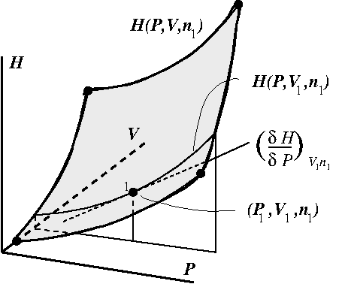
Introduce new energy function: Enthalpy H
(closed system)
Choose
P and V
as
independent
variables
T follows from the equationof state

Slide 35
Introduce new energy function: Enthalpy H
(closed system)
T follows from the equationof state
Constant V has less use in characteristic eq.

Slide 36
Helmholtz free energy and Gibbs free energy
(SG: page 8-10)
Helmholtz free energy A
Gibbs free energy G defined via the enthalpy H

Slide 37
Total differential of a state function:
Choose appropriate energy function
}
For a choice S and V :
For a choice S and P :
Characteristic
equations
For a choice V and T :
For a choice P and T :

Slide 38
Total differential of a state function:
Choose appropriate energy function
}
For a choice S and V :
For a choice S and P :
Characteristic
equations
For a choice V and T :
For a choice P and T :
Choice of P and V is possible but very inconvenient
[PV] = J and [ST] = J, so choose S,V or S,P or V,T or P,T
Choice of eg. T and P for H is tedious but possible
and can be advantageous
Exercise 4

Slide 39
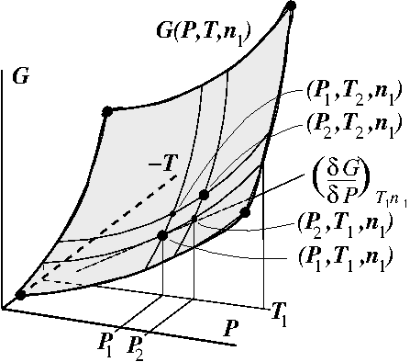
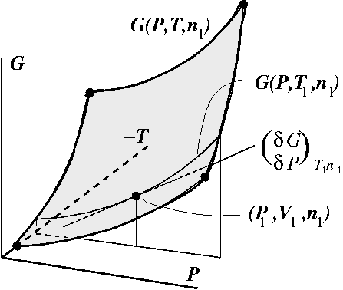
Total differential of a state function: G
Gibbs free energy
(closed system)
V follows from the equationof state
Process: (P₁,V₁,T₁,n₁) => (P₂,V₂,T₂,n₁)

Slide 40
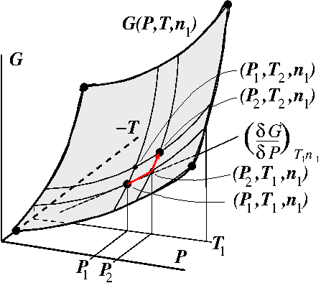
Total differential of a state function: G
(closed system)
V follows from the equationof state

Slide 41
Total differential of a state function: G
(closed system)
V follows from the equationof state

Slide 42
Total differential of a state function: G
G state function

Slide 43
Total differential of a state function: G
G state function
(Thermodynamics)
(Mathematics)
dG exact differential

Slide 44
Total differential of a state function: G
Any change in G
Total differential of G
Characteristic
(fundamental)
equation of G

Slide 45
Exact differential of a state function: Maxwell relation
Maxwell relation

Slide 46
General properties of a differentiable function: f(x,y)
(See Atkins (ed. 11): The chemist’s toolkit 9 (p. 44) or 10 (p. 105))
Euler chain relation
Exercise 2

Slide 47
Exact differential of a state function: Maxwell relations
So we can simply determine the change in entropy of a process running at constant T by integrating a more easily measurable quantity (∂V/∂T)_{P} over the pressure change during the process
Maxwell relations
Exercise 3

Slide 48
Exact differential of a state function: Maxwell relations
So we can simply determine the change in entropy of a process running at constant T by integrating a more easily measurable quantity (∂V/∂T)_{P} over the pressure change during the process
Maxwell relations
Let’s work this out in detail
Exercise 3

