Slide 1
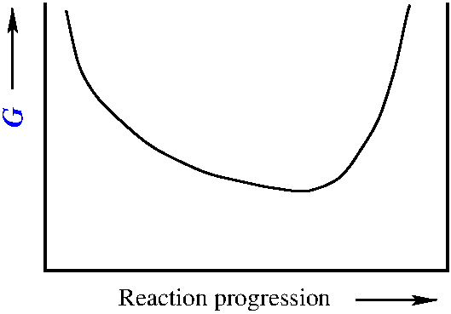
Classical thermodynamics: reaction equilibria: K
Second law→
Δ_{r}G
reaction
Equilibrium state
Energy minimum
T,P
0
Reaction progression ξ
1
ξ_{eq}
Equilibrium constant

Slide 2
Classical thermodynamics: reaction equilibria: K
Equilibrium:
Electrochemical equilibria:
Nernst
equation
Equilibrium:

Slide 3
Classical thermodynamics: reaction equilibria: K
Second law→
Δ_{r}G
reaction
E
Equilibrium state
Energy minimum
T,P
0
Reaction progression ξ
1
ξ_{eq}
Equilibrium constant

Slide 4
Classical thermodynamics: reaction equilibria: K
Activity a_{i}
Standard state ^{Ө}
pure compound in its reference state at T
^{(still T dependent)}
perfect gas
P_{i} : partial pressure
f_{i} : fugacity
real gas
(pure) solid
(pure) liquid

Slide 5
Activity (liquid) mixtures of neutral components
Activity a_{i}
{
Standard state *
^{(still T dependent)}
^{Vapour pressure pure liquid i}
Ideal solutions (Raoult)
Real solutions
γ_{i} : activity coefficient

Slide 6
Activity (liquid) mixtures of neutral components
Activity a_{i}
{
Standard state *
^{(still T dependent)}
^{Vapour pressure pure liquid i}
Ideal solutions (Raoult)
Real solutions
γ_{i} : activity coefficient

Slide 7
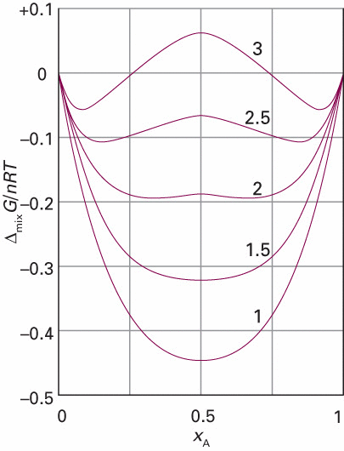
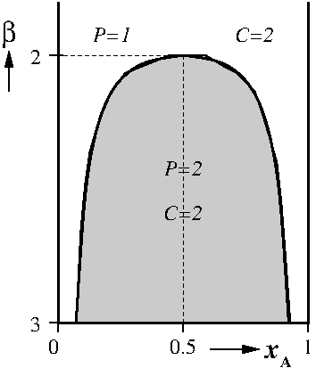
Activity (liquid) mixtures of neutral components
Regular solution example:
(L-L separation exercise 17)
β =

Slide 8
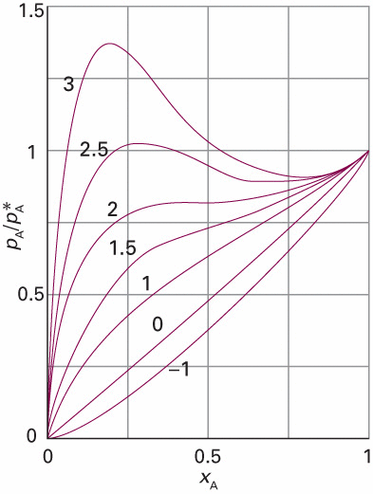
Activity (liquid) mixtures of neutral components
Regular solution example:
(L-L separation exercise 17)
β =
β =
(See also
Additional exercises I
Exercise A4)

Slide 9
Activity coefficients solutes electrolytic solutions

Slide 10
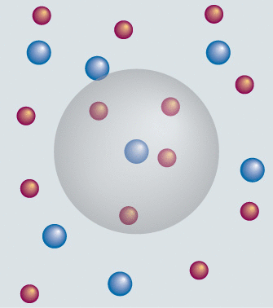
Activity coefficients solutes electrolytic solutions
chemical potential of dissolved salt
^{example}
^{example}
^{If solubility is}
^{(mol/kg) then}

Slide 11
Activity coefficients solutes electrolytic solutions
chemical potential of dissolved salt

Slide 12
Activity coefficients solutes electrolytic solutions
chemical potential of dissolved salt
It is impossible to determine (measure) ^{and} ^{individually}
Mean activity coefficient

Slide 13
Activity coefficients solutes electrolytic solutions
chemical potential of dissolved salt
Let’s work this out in detail
Mean activity coefficient

Slide 14
Activity coefficients solutes electrolytic solutions
chemical potential of dissolved salt

Slide 15
Activity coefficients solutes electrolytic solutions
chemical potential of dissolved salt
^{Real solution:}

Slide 16
Activity coefficients solutes electrolytic solutions
chemical potential of dissolved salt

Slide 17
Activity coefficients solutes electrolytic solutions
chemical potential of dissolved salt
average chemical potential per ion
^{(i labels any of the ions)}
(The solution has to be electrically neutral)

Slide 18
Activity coefficients solutes electrolytic solutions
chemical potential of dissolved salt
average chemical potential per ion
^{Mean activity coefficient}

Slide 19
Mean activity coefficient: Debye-Hückel
(ions i of a dissolved salt)
Mean activity coefficient

Slide 20
Mean activity coefficient: Debye-Hückel
(ions i of a dissolved salt)
Mean activity coefficient
Debye-Hückel:
(limiting law)
Ionic strength
(sum over all ions in solution)
A = 0.509 for H₂O @ 298 K

Slide 21
Activity coefficients solutes electrolytic solutions
Debye-Hückel:
Ionic strength
Mean activity coefficient
^{Example}
Sum over all ions in the solution

Slide 22
Activity coefficients solutes electrolytic solutions
Debye-Hückel:
Ionic strength
Mean activity coefficient
^{Example}
relative molality

Slide 23
Activity coefficients solutes electrolytic solutions
Debye-Hückel:
Ionic strength
Mean activity coefficient
^{Example}

Slide 24
Activity coefficients solutes electrolytic solutions
Debye-Hückel:
Ionic strength
Mean activity coefficient
^{Example}
Exercise 26-28

Slide 25
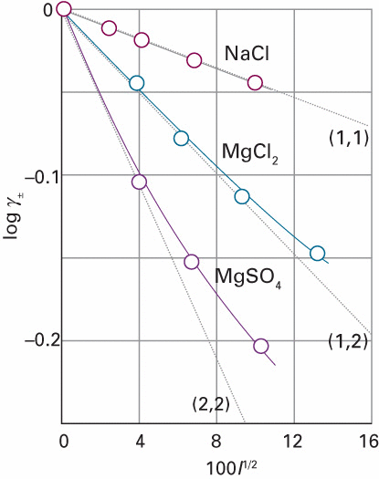
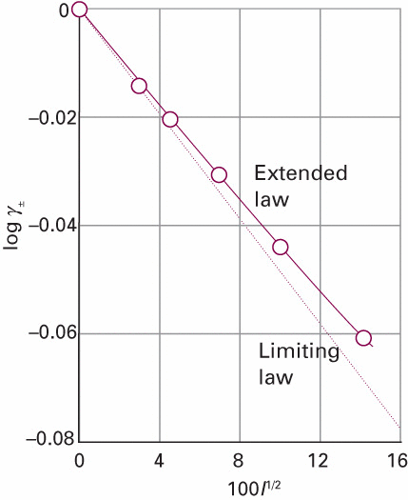
Activity coefficients solutes electrolytic solutions
extended Debye-Hückel:
6 mmol/kg

Slide 26
Activity coefficients solutes electrolytic solutions
extended Debye-Hückel:
Ideal solution
6 mmol/kg

Slide 27
Activity coefficients solutes electrolytic solutions
6 mmol/kg

Slide 28
Activity coefficients solutes electrolytic solutions
Ideal mixing entropy
Reduces mixing entropy
due to the electrostatic
attraction and repulsion
6 mmol/kg

Slide 29
Statistical Thermodynamics: Boltzmann distribution

Slide 30
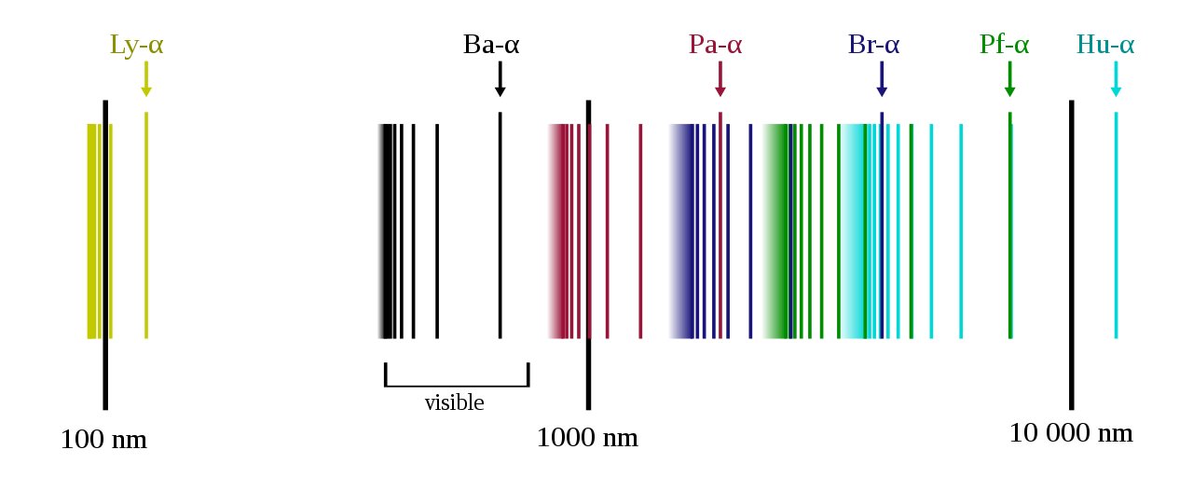
Statistical Thermodynamics: Boltzmann distribution
Quantum Mechanics: discrete energy levels
(discrete energy spectrum)
The discrete part of the emission spectrum of hydrogen
Source: https://en.wikipedia.org/wiki/Discrete_spectrum

Slide 31
Statistical Thermodynamics: Boltzmann distribution
Quantum Mechanics: discrete energy levels
(discrete energy spectrum)
ε_{i} is the energy of a molecule in
quantum state or quantum level i

Slide 32
Statistical Thermodynamics: Boltzmann distribution
Quantum Mechanics: discrete energy levels
Boltzmann distribution:
P_{i}: chance to occupy ε_{i}
Average number of molecules
in quantum state ε_{i}
Total number of molecules
Partition function

Slide 33
Statistical Thermodynamics: Boltzmann distribution
Quantum Mechanics: discrete energy levels
Boltzmann distribution
Partition function
Study Guide page 20

Slide 34
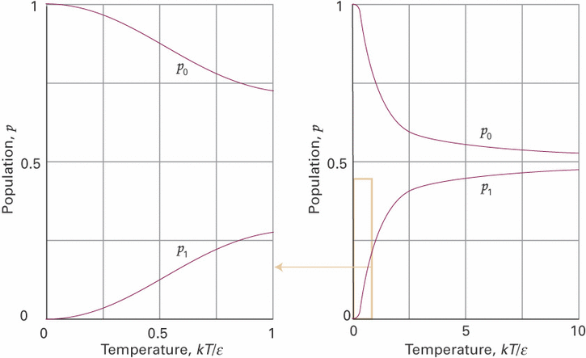
Statistical Thermodynamics: Boltzmann distribution
Two level system
choice

Slide 35
Statistical Thermodynamics: Boltzmann distribution
Two level system
Exercise 29-30

Slide 36
Statistical Thermodynamics: Boltzmann distribution
Quantum Mechanics: discrete energy levels
Boltzmann distribution
Partition function
Boltzmann entropy
Study Guide page 21
https://dullenslab.com/teaching/ (Lecture 7)

Slide 37
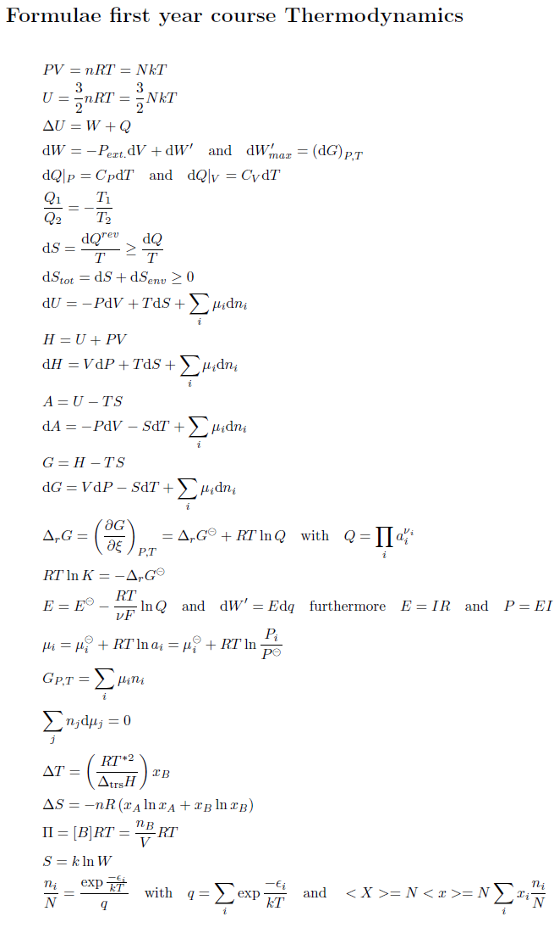

Slide 38
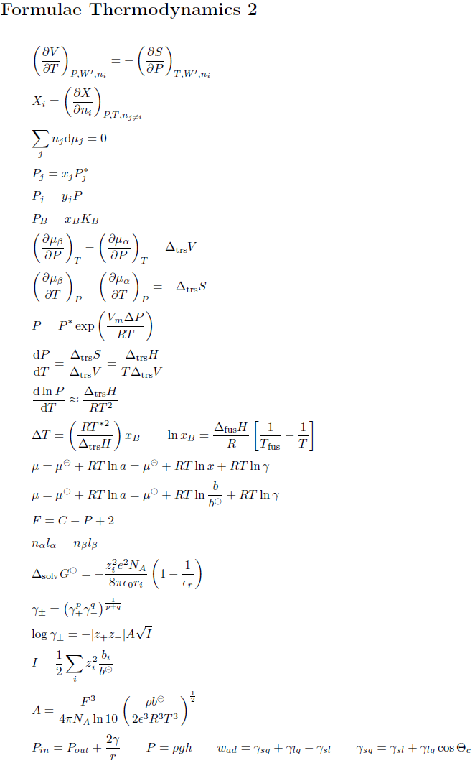

Slide 39
Mean activity coefficient: Debye-Hückel
Only in case you are interested in the background of the
Debye-Huckel theory (not necessary for the exam)
https://learninglink.oup.com/access/pchem11e-student-resources#tag_a-deeper-look

Slide 40
Mean activity coefficient: Debye-Hückel
1) Work to charge all ions starting from an ideal solution with all (uncharged) ions already in their ideal solution positions is :
Choose a central ion i with
charge q_{i} in the solution

Slide 41
Mean activity coefficient: Debye-Hückel
2) Ionic atmosphere (all other charges q_{j}) will screen the charge of the central ion :
Poisson:

Slide 42
Mean activity coefficient: Debye-Hückel
2) Ionic atmosphere (all other charges q_{j}) will screen the charge of the central ion :
Poisson:

Slide 43
Mean activity coefficient: Debye-Hückel
3) Use Boltzmann distribution to determine ion distribution in the bulk solution:
Energy of ion j:
Boltzmann:
Charge density ion j:

Slide 44
Mean activity coefficient: Debye-Hückel
3) Use ion distribution to find Debye screening length:
Mass density solvent
Ionic strength
Poisson
Debye screening length

Slide 45
Mean activity coefficient: Debye-Hückel
3) Use ion distribution to find Debye screening length:
Mass density solvent
Ionic strength
Poisson
Debye screening length

Slide 46
Mean activity coefficient: Debye-Hückel
4) Determine work to charge central ion in presence of the ionic atmosphere potential:

Slide 47
Mean activity coefficient: Debye-Hückel
5) Collect all results and include charging of all ions in w_{e} :
A = 0.509 for H₂O @ 298 K

